Slide 1
Workflow
Quality Control (QC)
Determines whether experimental data can be used for BMD calculations
If QC
0-1
Report dose_response_auc only and exit
2-4
Apply all models and decide the best model
If unique model is found
Report all BMDs with the best model
If non-unique models are found
If valid model prediction is found
Otherwise, report poor data or no-convergence
Paritosh volunteered to make workflow

Slide 2
Curious inquiry
“Another topic for discussion is whether our minimum data requirements or curve fitting criteria are too stringent such that we are not calculating curves for many of the endpoints. I think we’ve optimized this in the past, but it was a very manual process. It has to be a more automated process moving forward, so there will be some give and take in that.“

Slide 3
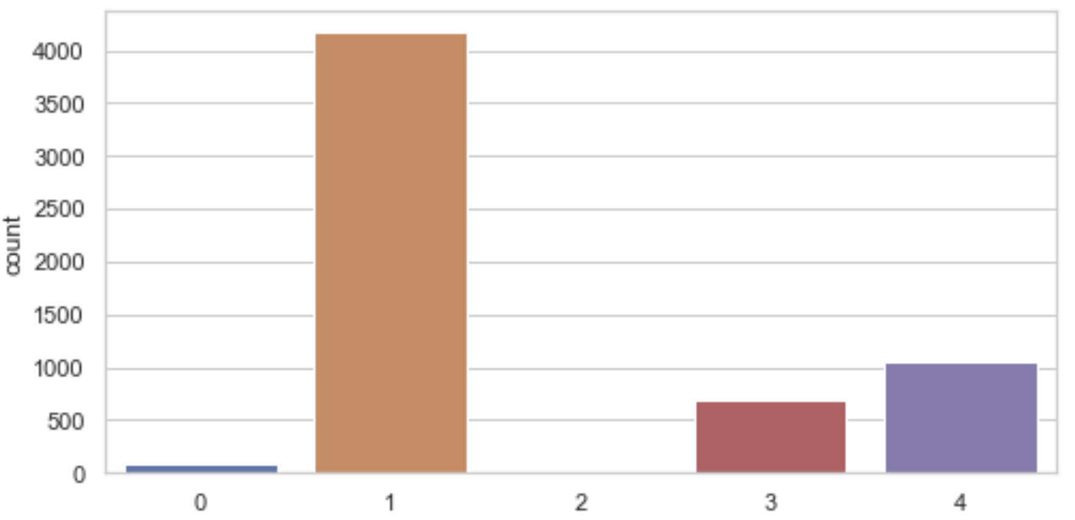
Paritosh’s code systematically validate experimental data (“quality control”) before BMD calculation
0: Not enough dose groups for BMD analysis. BMD analysis not performed
There are fewer than 3 dose groups
1: No trend detected in dose-response data. BMD analysis not performed
If the average response for the first two dose groups is higher than
the average response at the last two dose groups indicating an
overall decreasing trend (1197 / 4170)
Or
If the mean first order differences of responses is 0 indicating a flat response
(determined by a t-test with p-value >= 0.62)
(2973 / 4170)
(ref. 2012. US EPA Benchmark Dose Technical Guidance p15)
2: Very good dose-response data
p-value for non-flat curve < 0.05
3: Good dose-response data. BMD analysis might be less reliable
p-value for non-flat curve < 0.32
4: Data resolution poor. BMD analysis might be unreliable
p-value for non-flat curve < 0.62
With 6,048 cases
(=336 chemicals x 18 endpoints)
Since most qc is 1, one possible solution could
be adding much higher concentrations of chemicals,
so that more BMD calculations can be possible

Slide 4
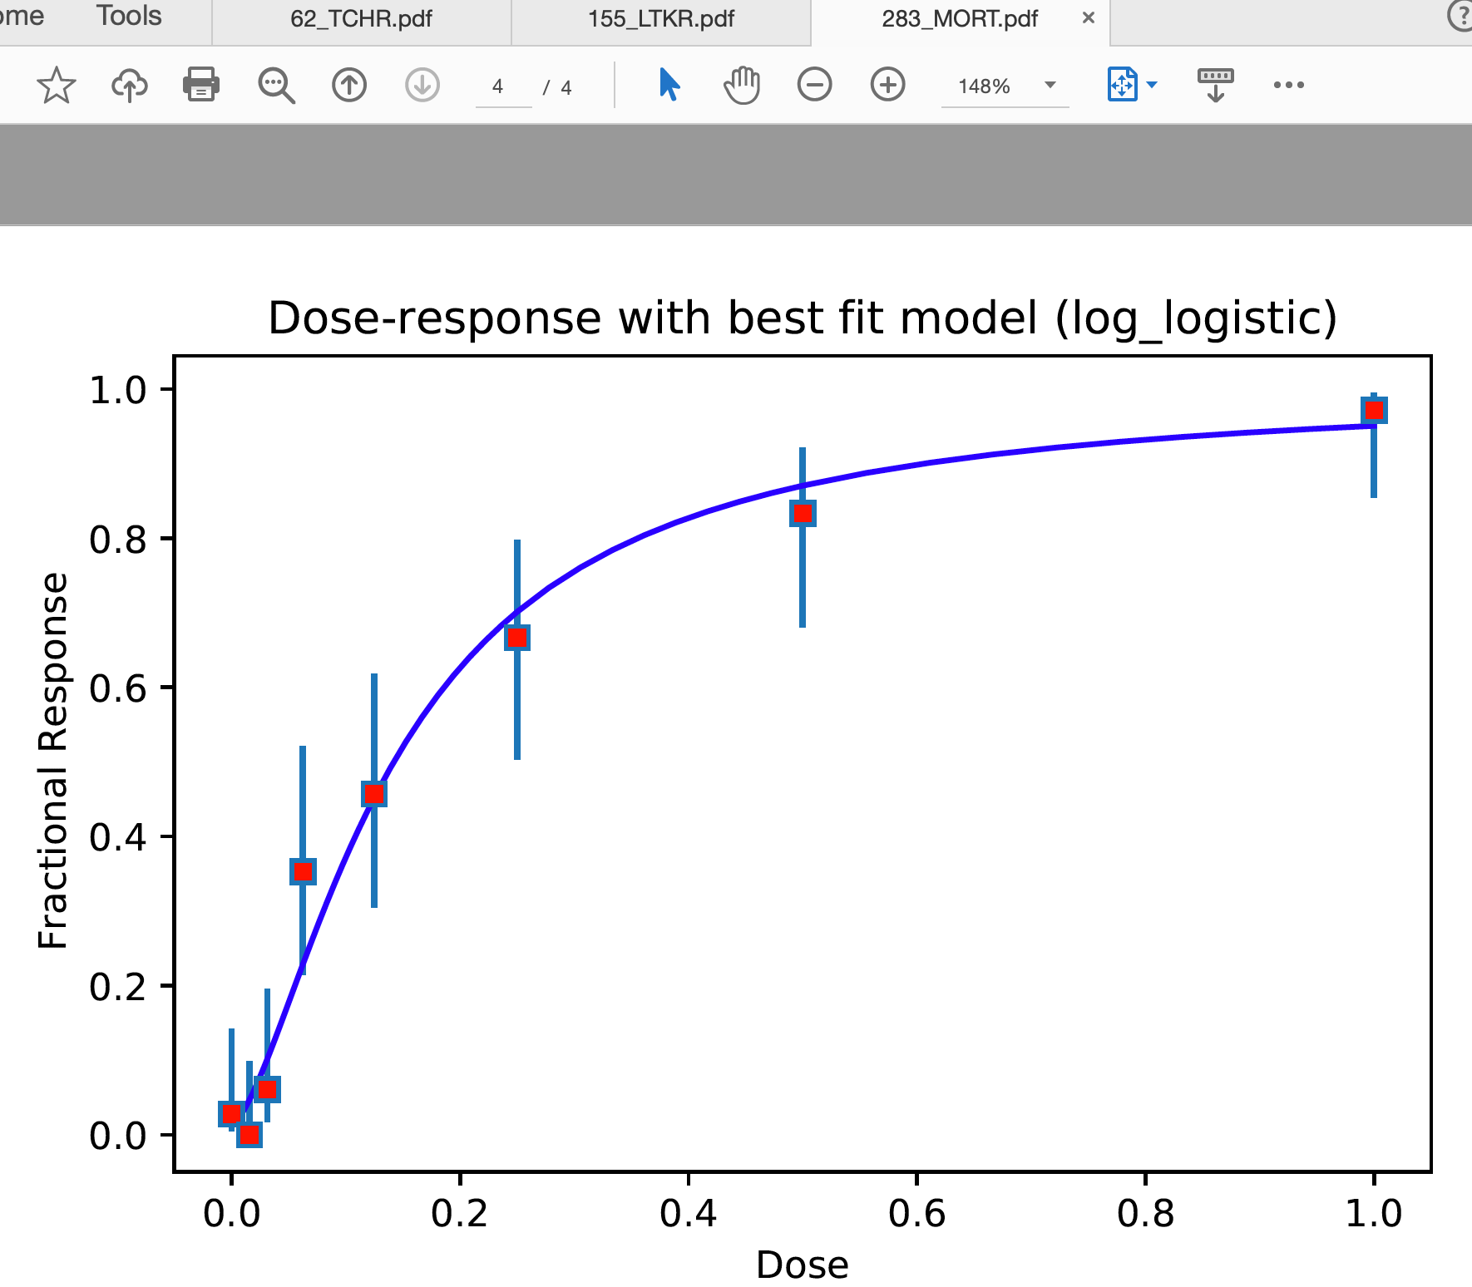
Explanation of dose-response curve
Red dot → response in
dose_response_vals
Blue bar → confidence interval
(low, high)
frac_response
= dose_response['num_affect’]
/dose_response['num_embryos']

Slide 5
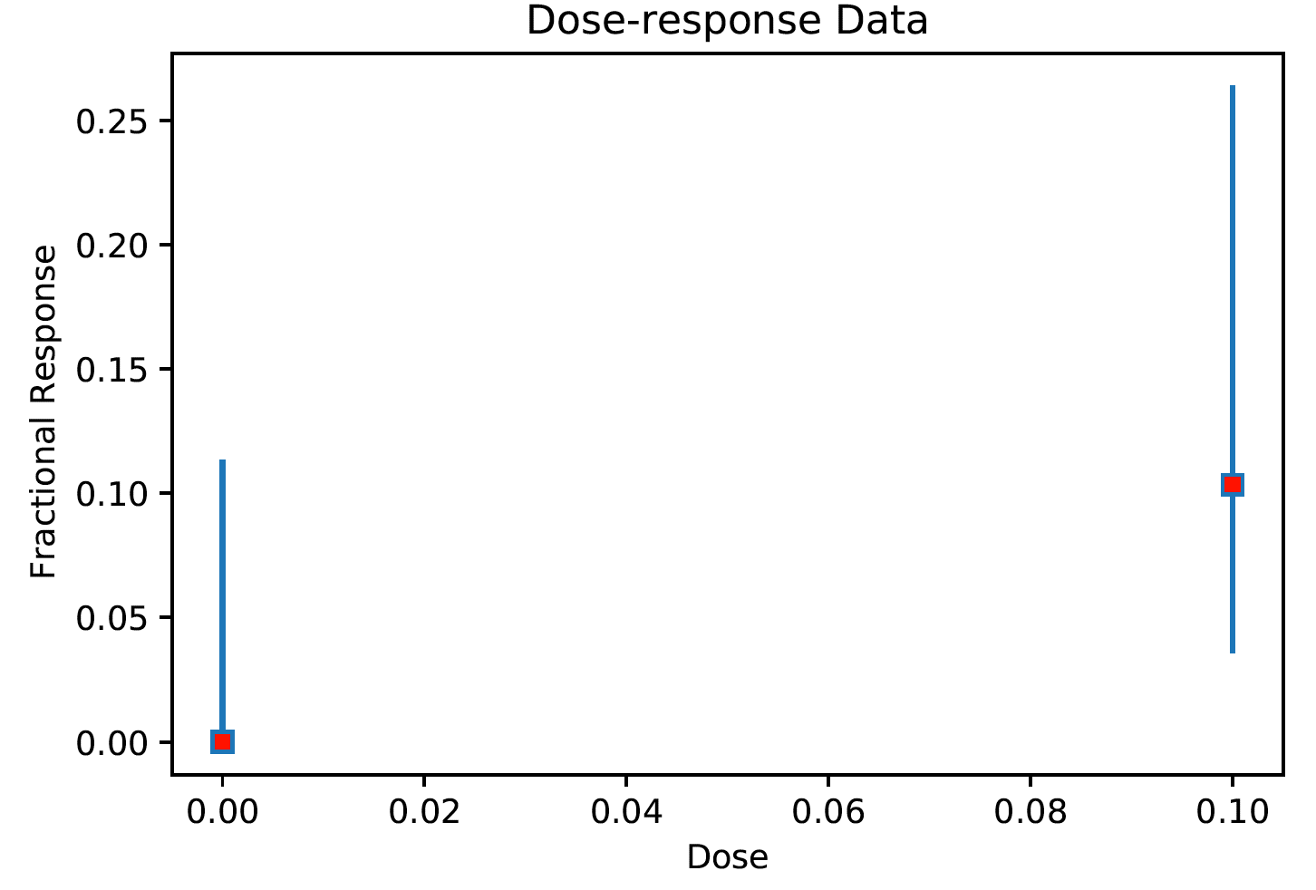
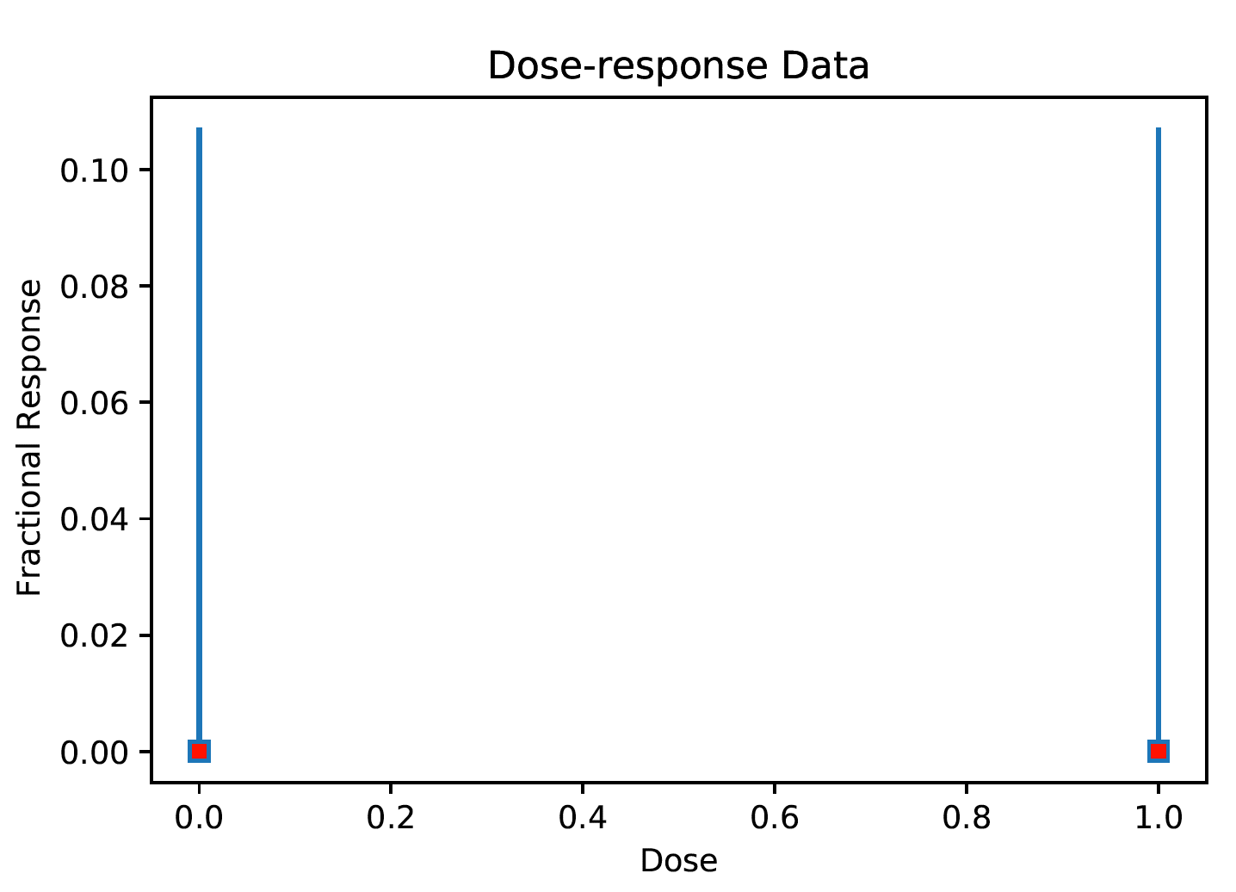
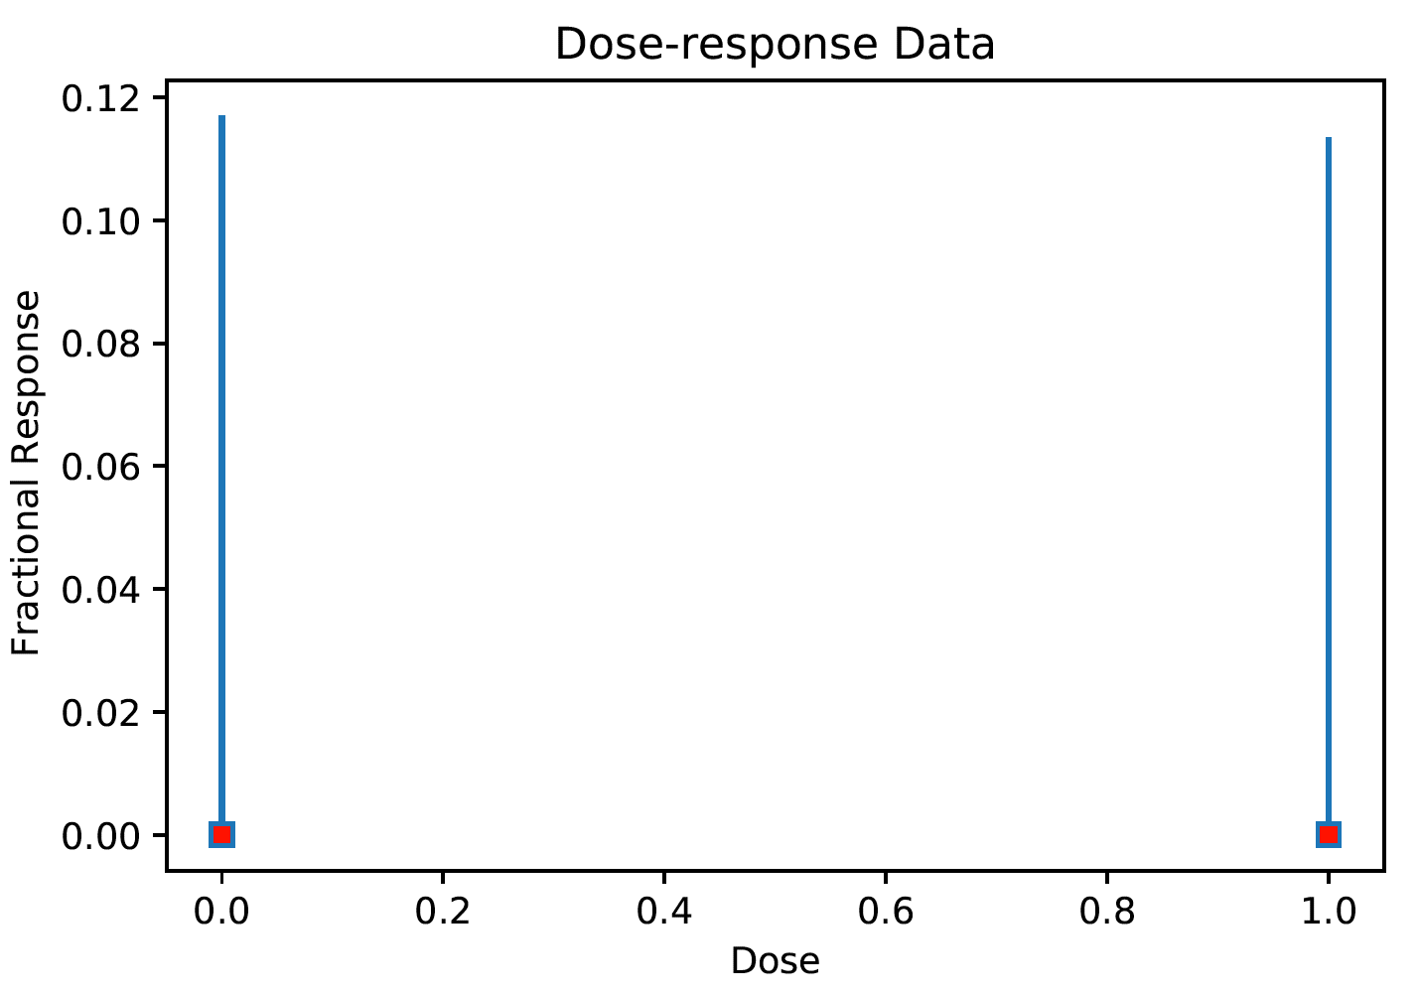
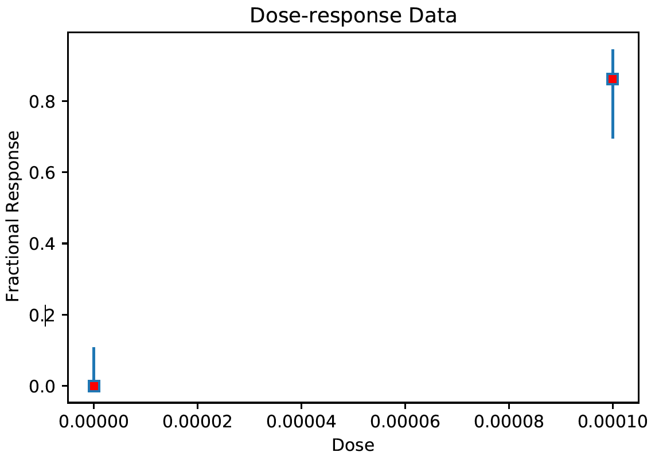
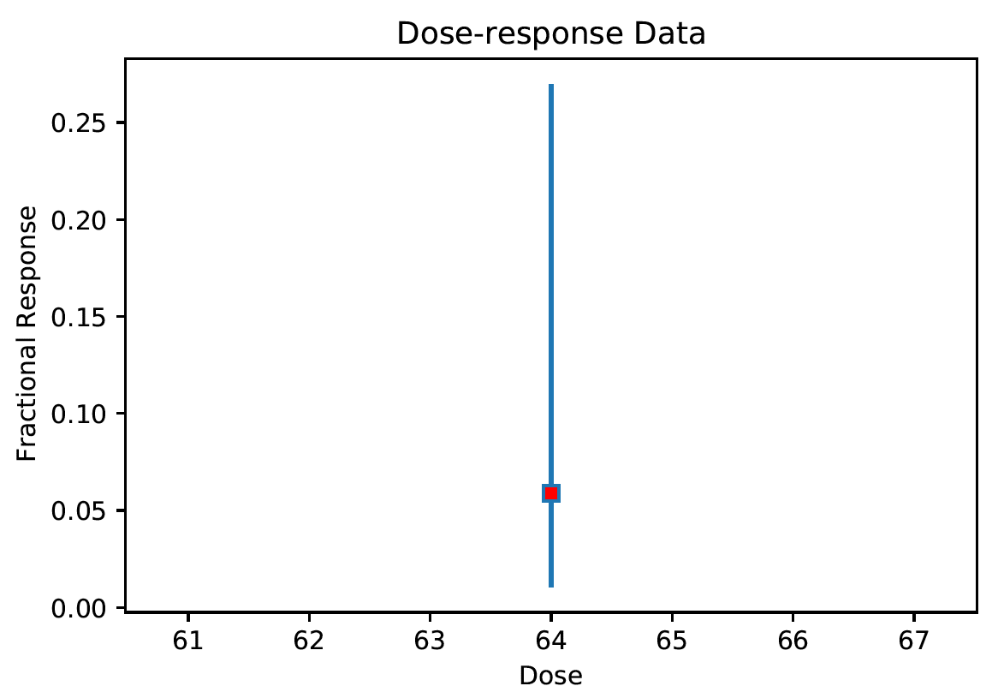
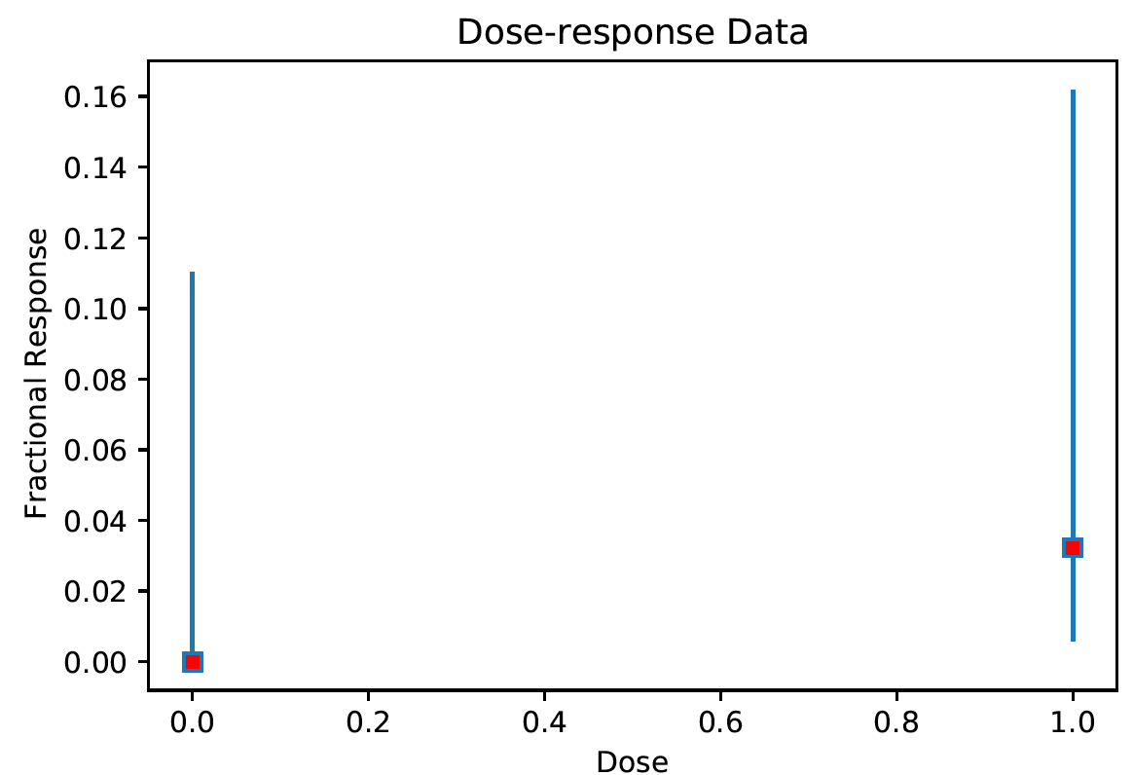
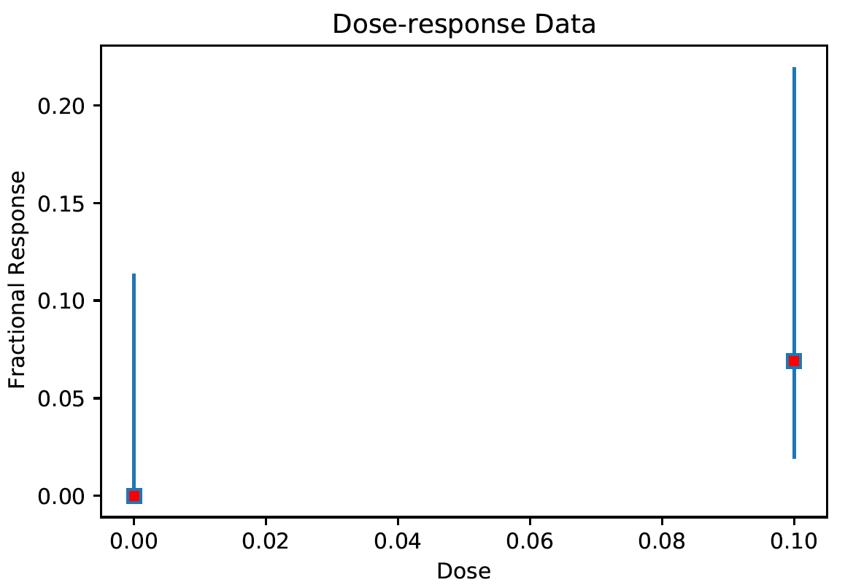
0: Not enough dose groups for BMD analysis.
Among 6,048 cases (=336 chemicals x 18 endpoints),
93 cases reported < 3 dose groups

Slide 6
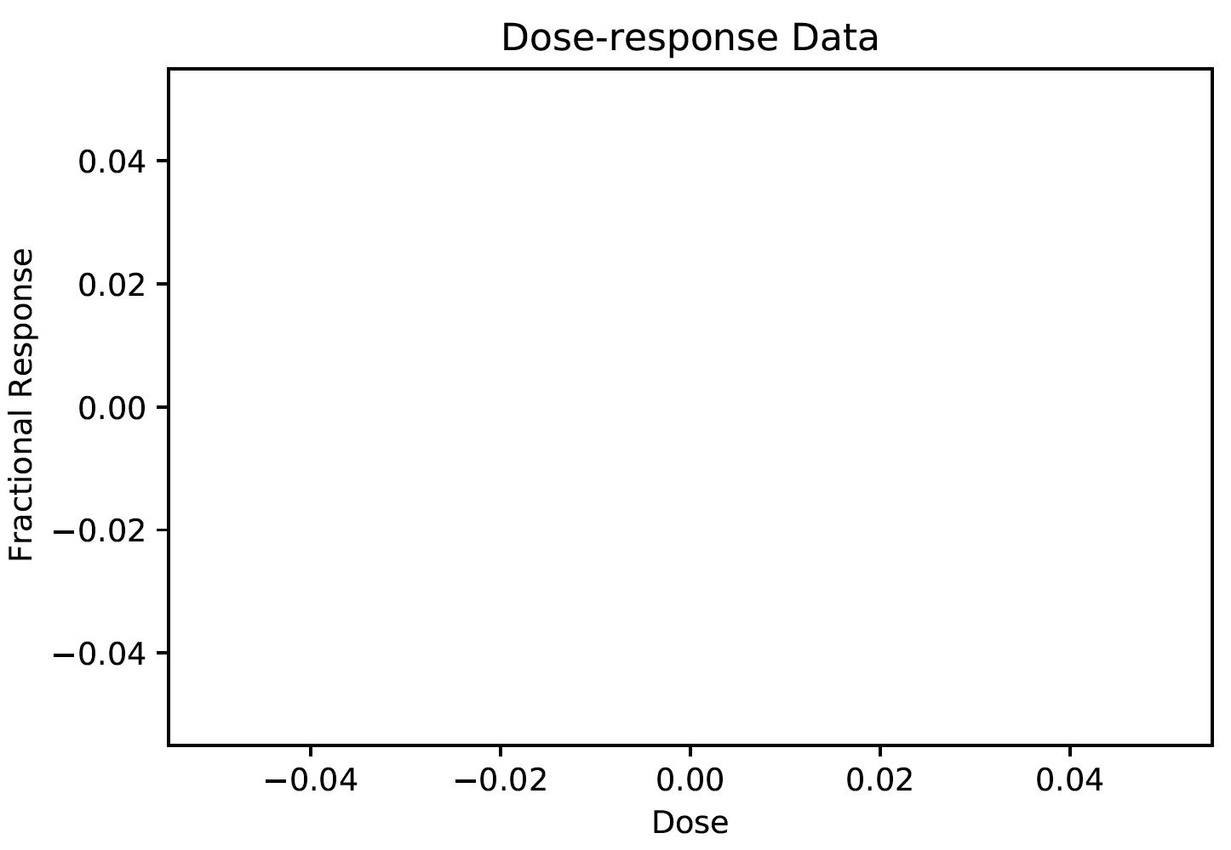
0: Not enough dose groups for BMD analysis.
Among 6,048 cases (=336 chemicals x 18 endpoints),
93 cases have < 3 dose groups
chemical.id | conc | PE__ | YSE_
1532 | 64
1532 | 6.4 | 0 | 0
1532 | 0.64 | 0 | 0
1532 | 0.064 | 0 | 0
1532 | 0.0064
1532 | 0
1532 | 64 | 0 | 0
1532 | 6.4 | 0 | 0
1532 | 0.64
1532 | 0.064 | 0 | 0
1532 | 0.0064 | 0 | 0
1532 | 0
1532 | 64
1532 | 6.4
1532 | 0.64
1532 | 0.064
1532 | 0.0064
1532 | 0
1532 | 64
1532 | 6.4
1532 | 0.64
1532 | 0.064
1532 | 0.0064
1532 | 0
1532 | 64
1532 | 6.4
1532 | 0.64
1532 | 0.064 | 0 | 0
1532 | 0.0064 | 0 | 0
1532 | 0 | 0 | 0
1532 | 64
1532 | 6.4
1532 | 0.64 | 0 | 0
1532 | 0.064
morphological_data['EDEM'] = morphological_data[['YSE_','PE__']].sum(axis=1,skipna=True,min_count=1)
At least half wells
1532_EDEM

Slide 7
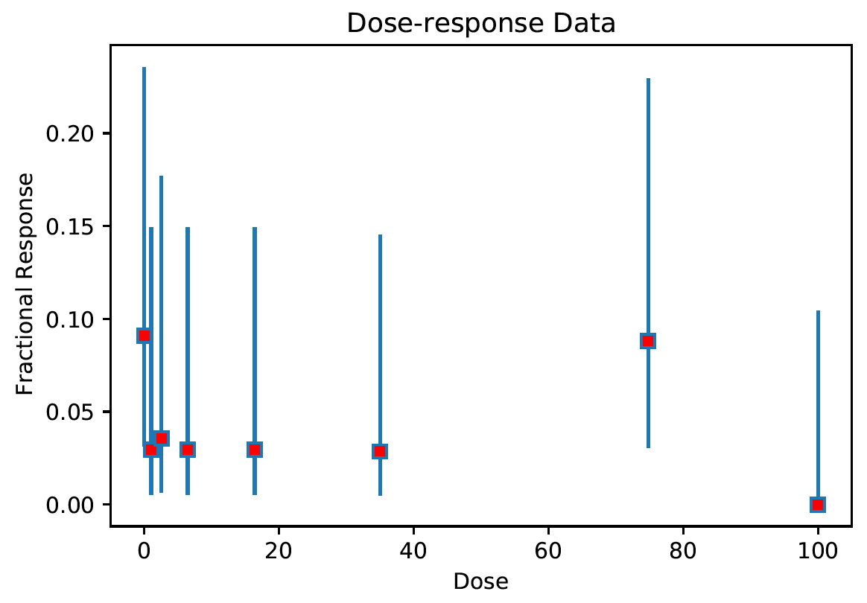
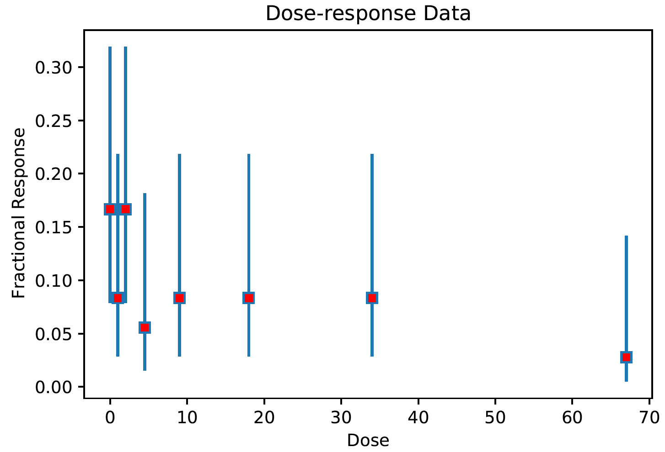
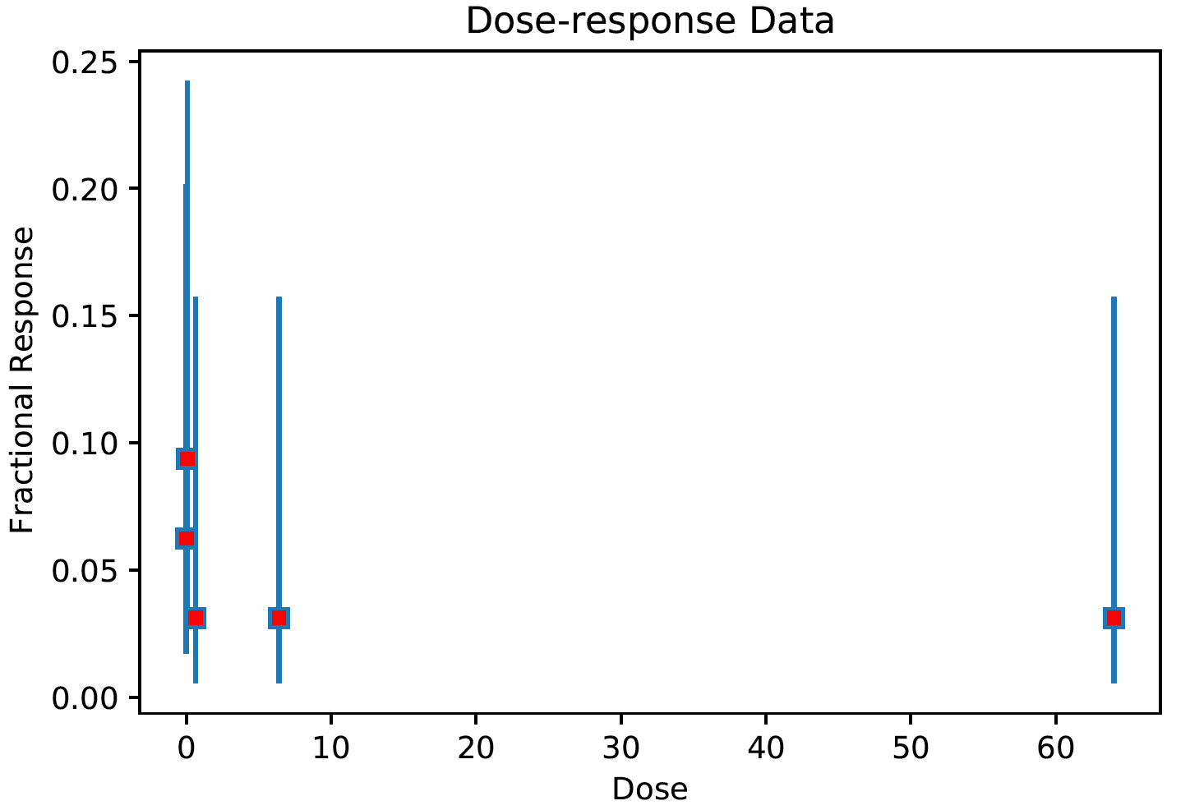
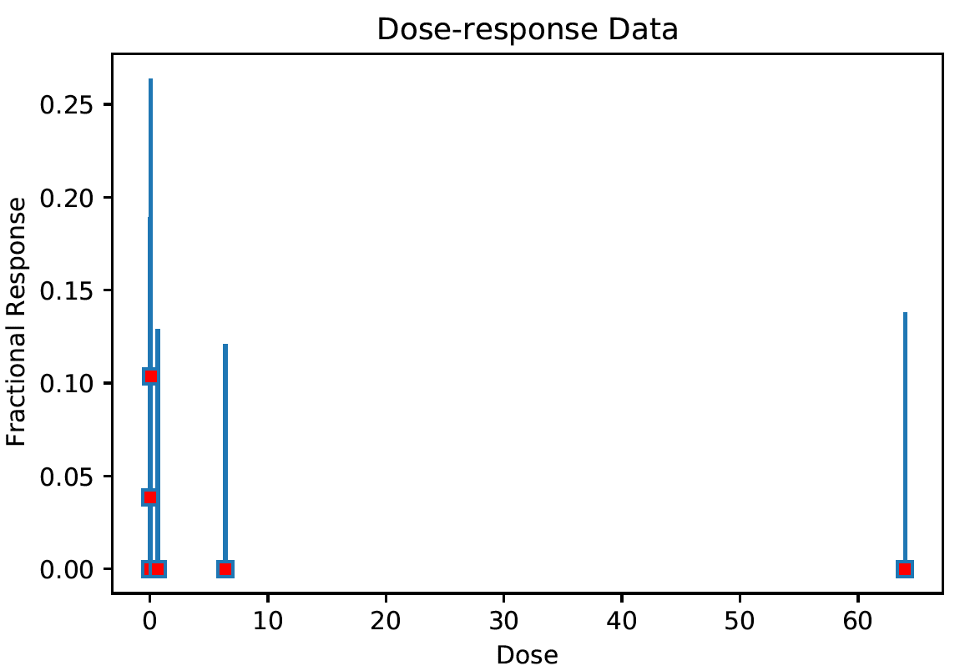
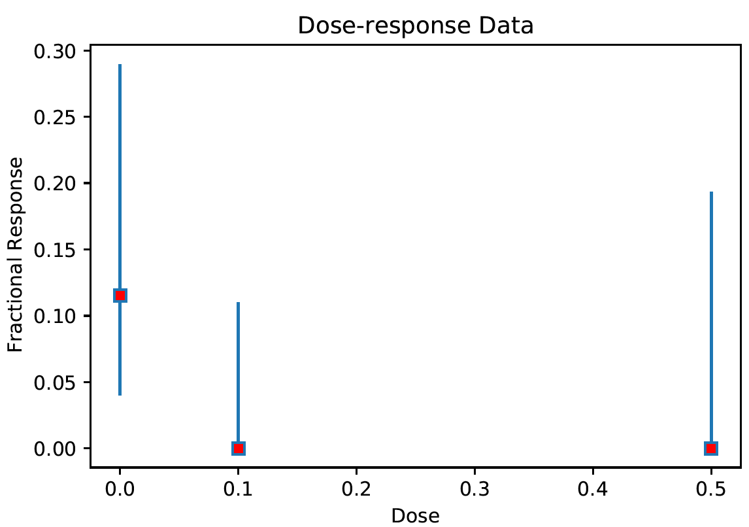
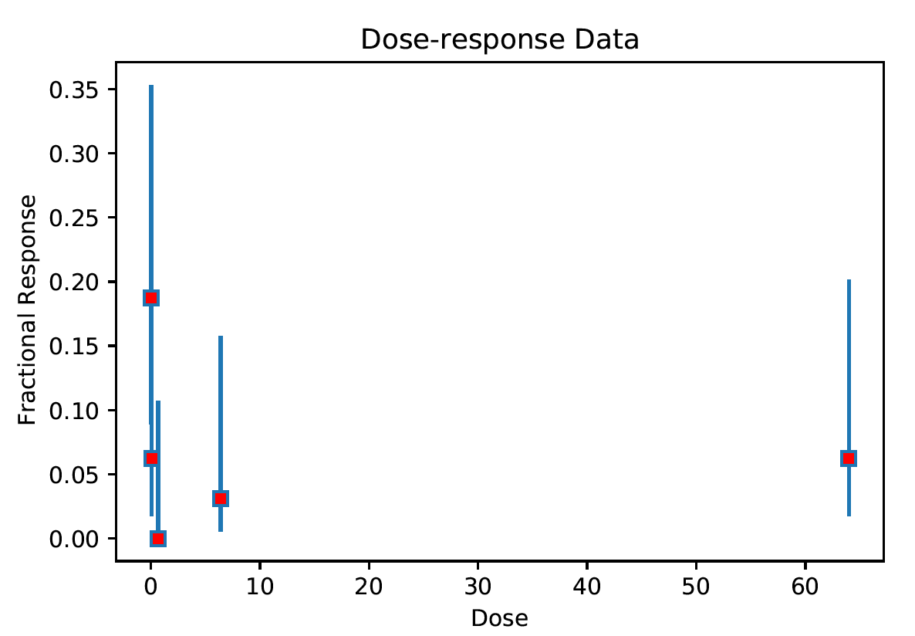
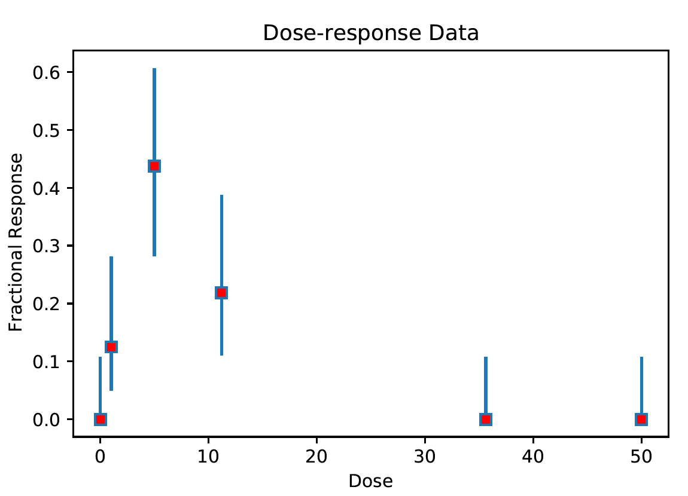
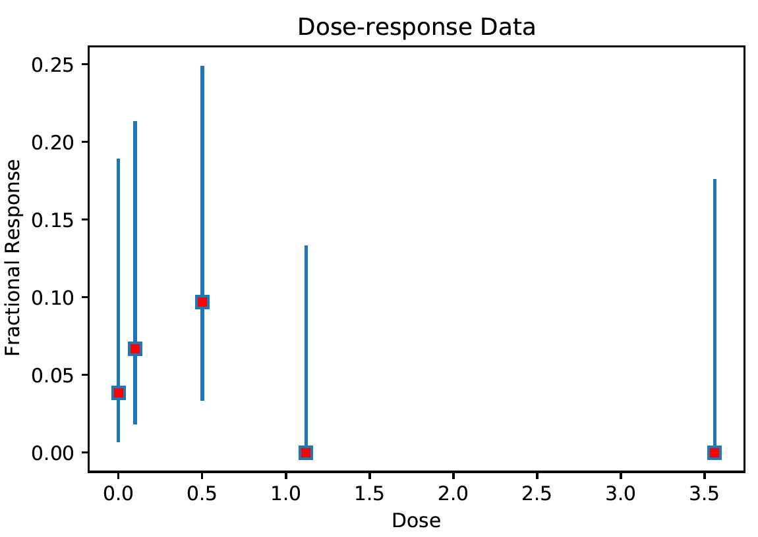
1: No trend detected in dose-response data show decreasing trend (e.g. average response for the first two dose groups is higher than the average response at the last two dose groups
Among 6,048 cases (=336 chemicals x 18 endpoints),
1,197 cases

Slide 8
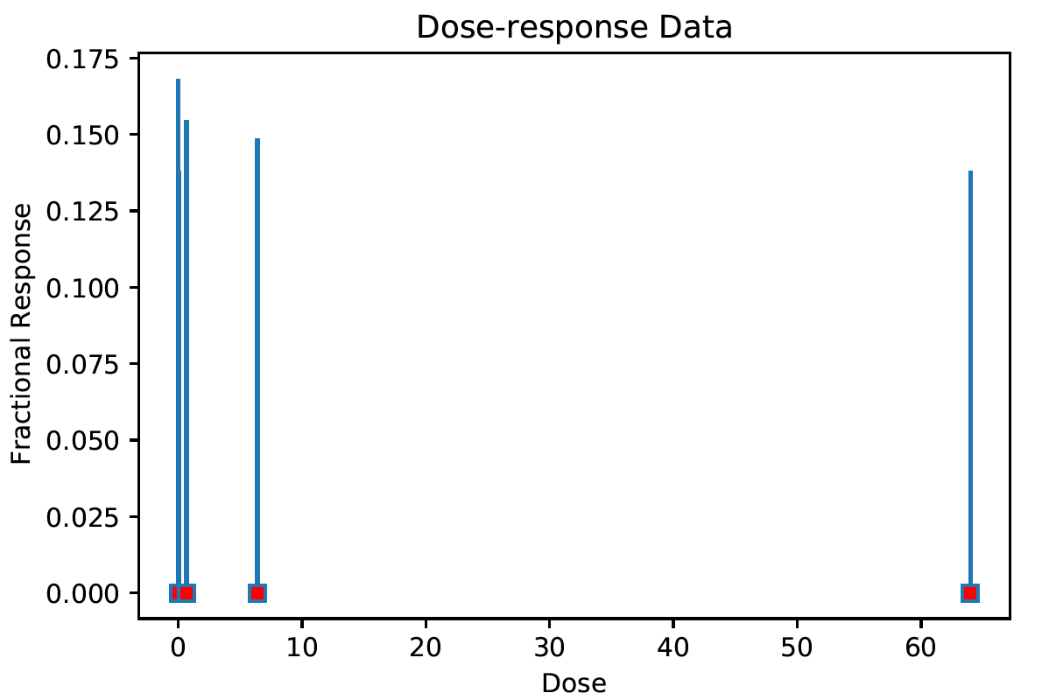
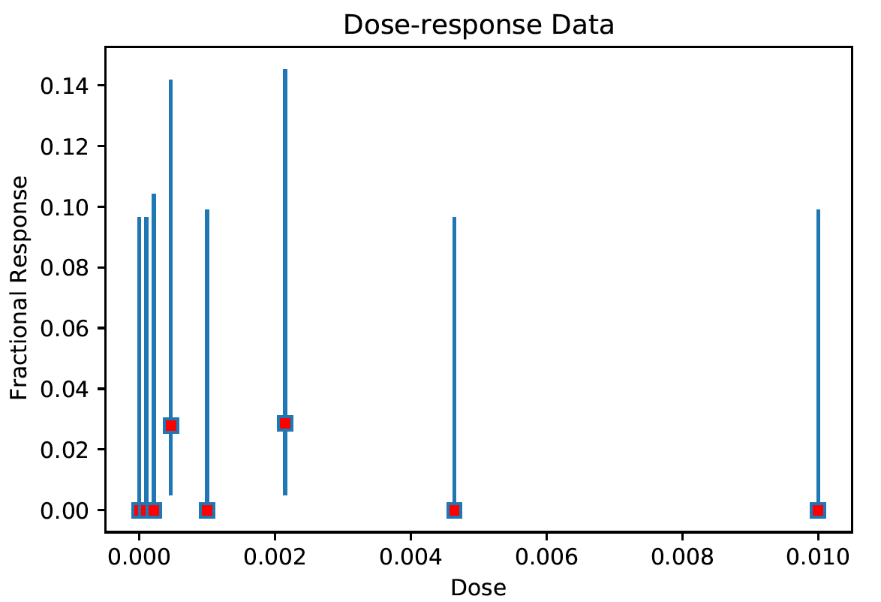
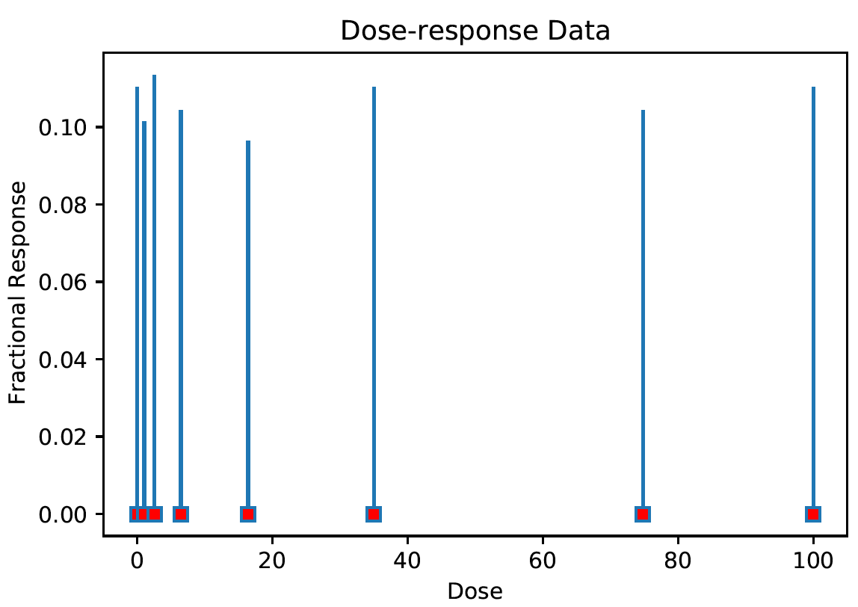
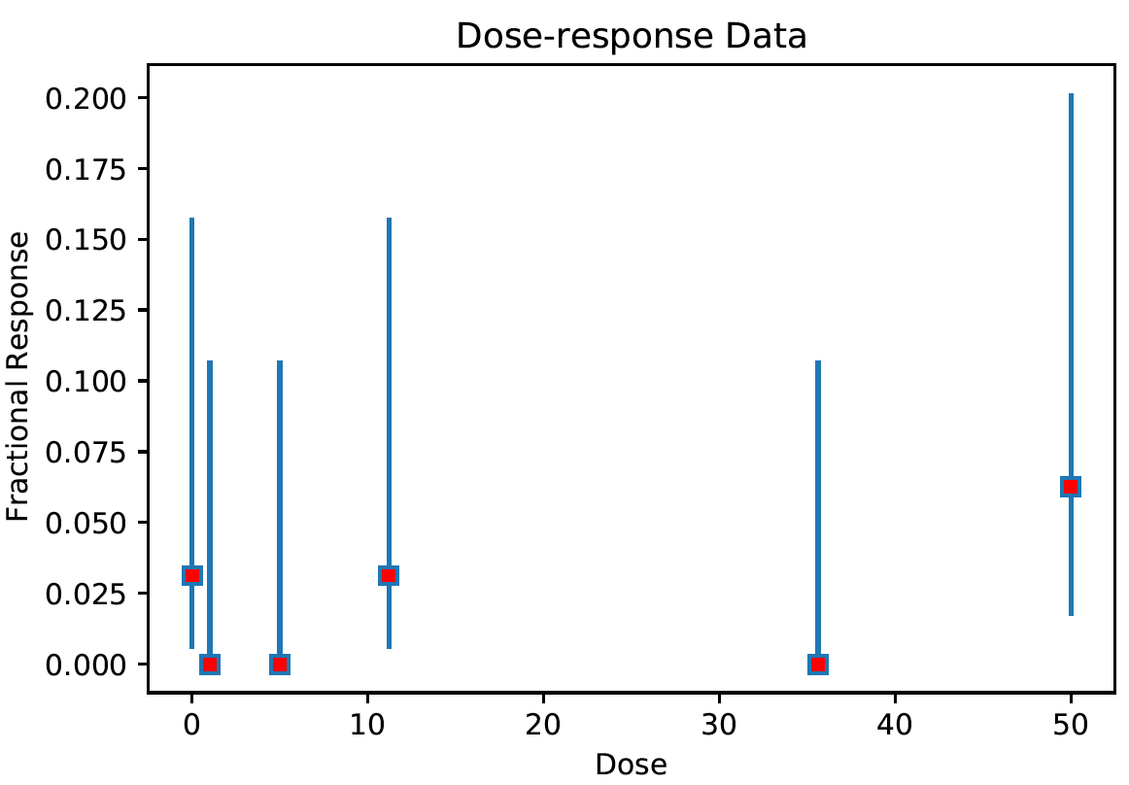
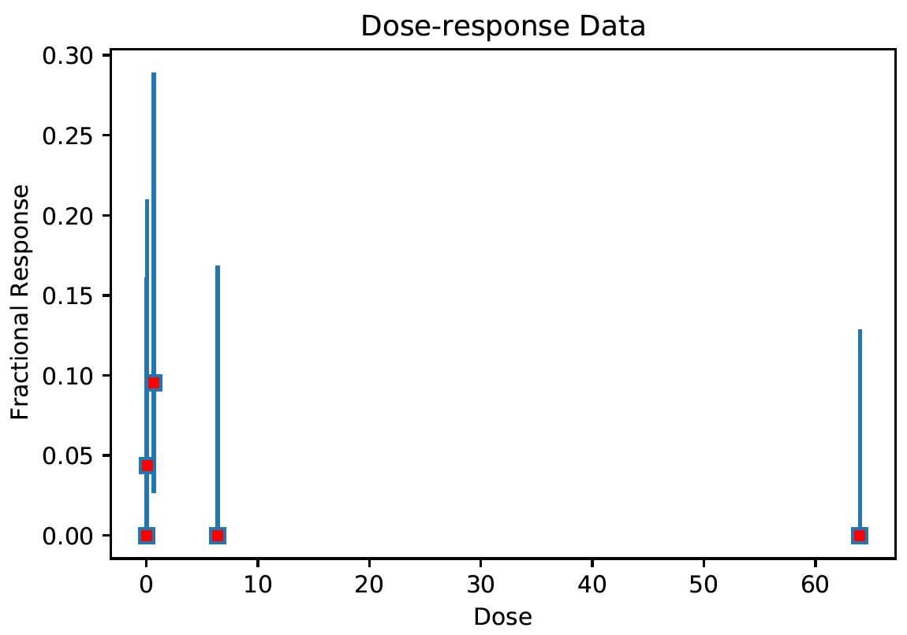
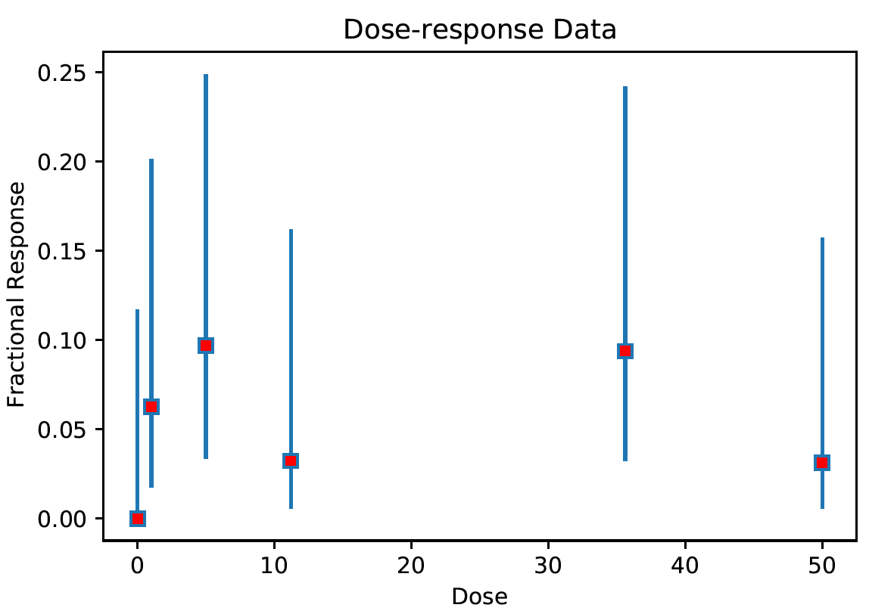
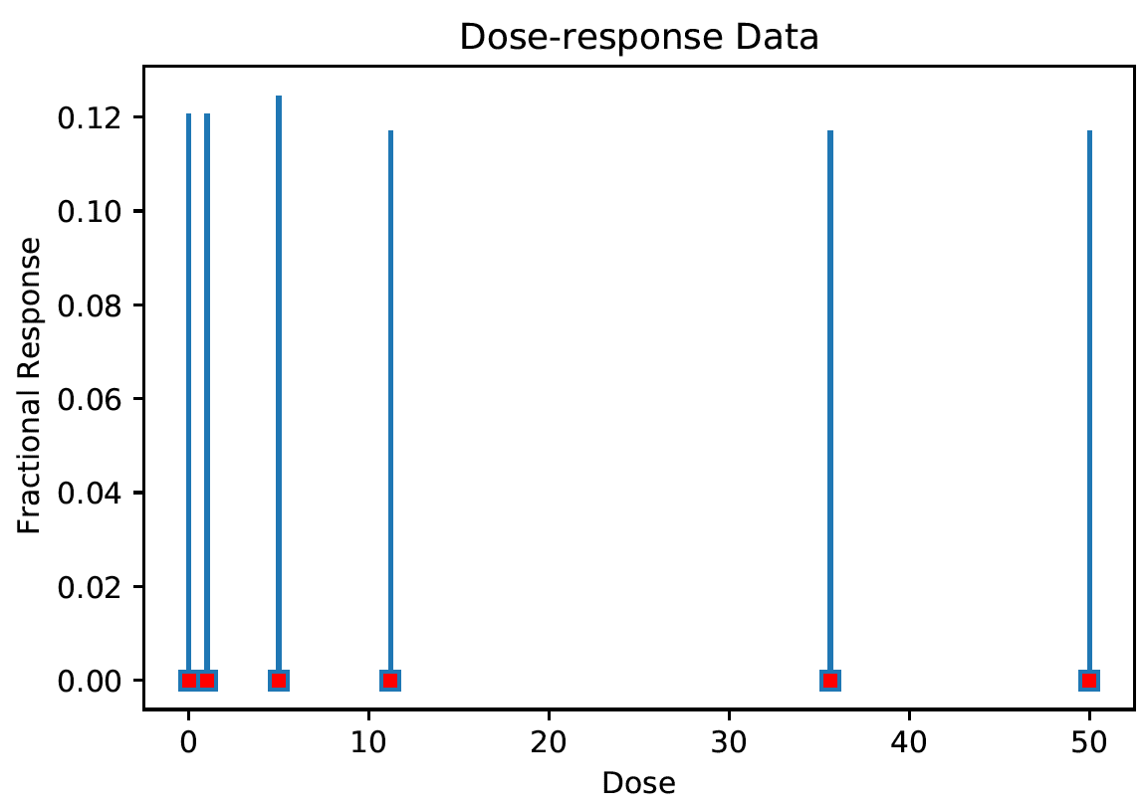
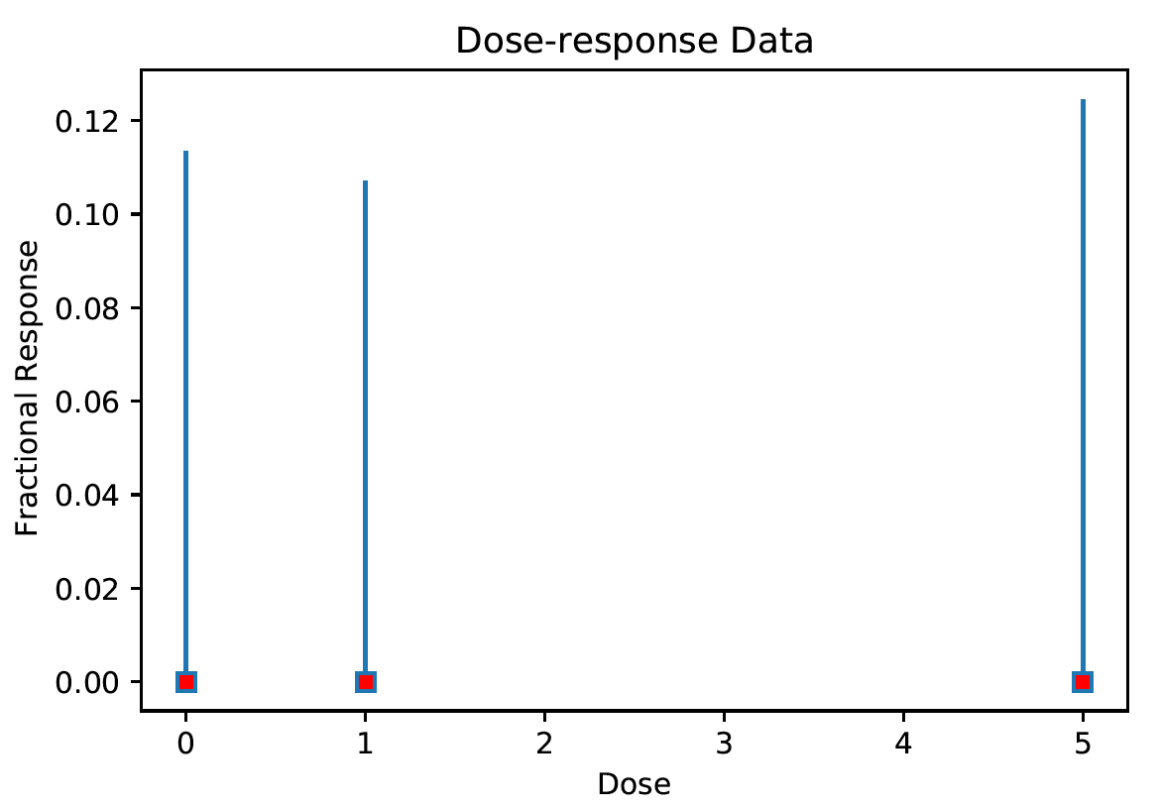
1: No trend detected in dose-response data a flat response along with increase of chemical concentration
Among 6,048 cases (=336 chemicals x 18 endpoints),
2,973 cases

Slide 9
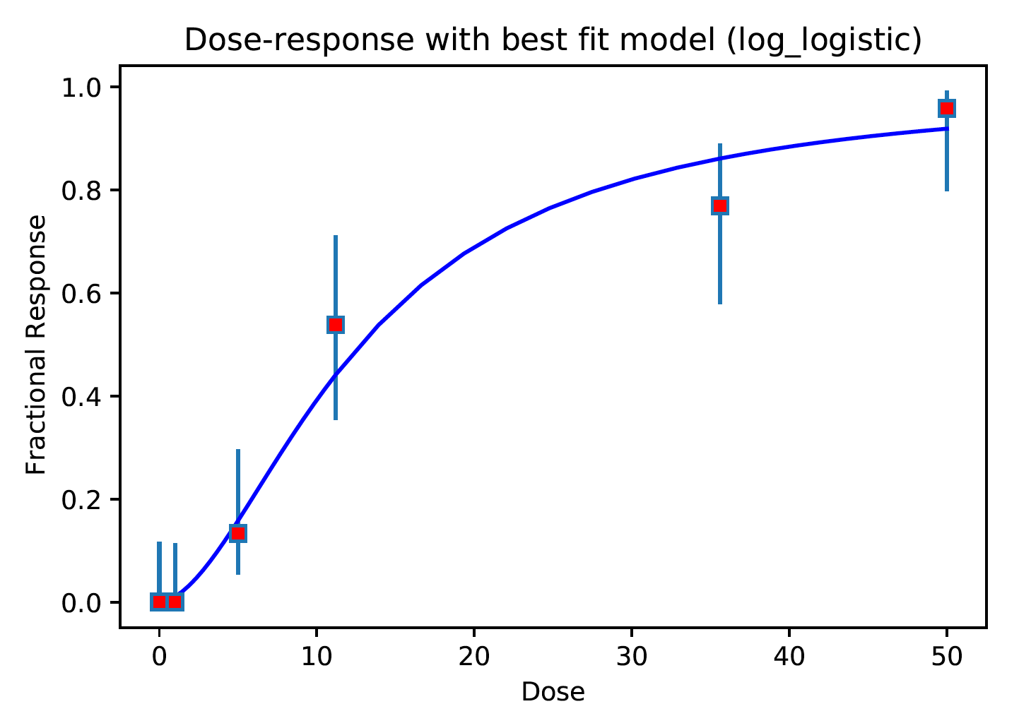
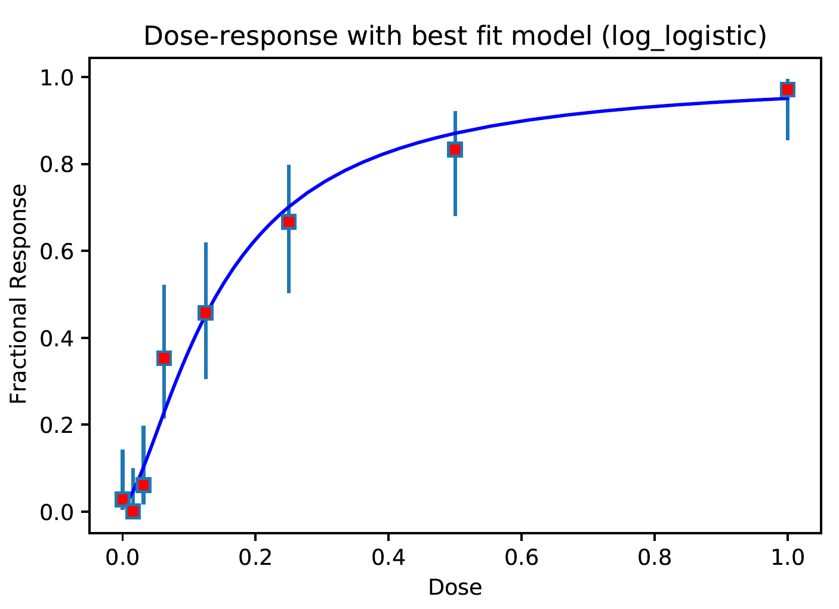
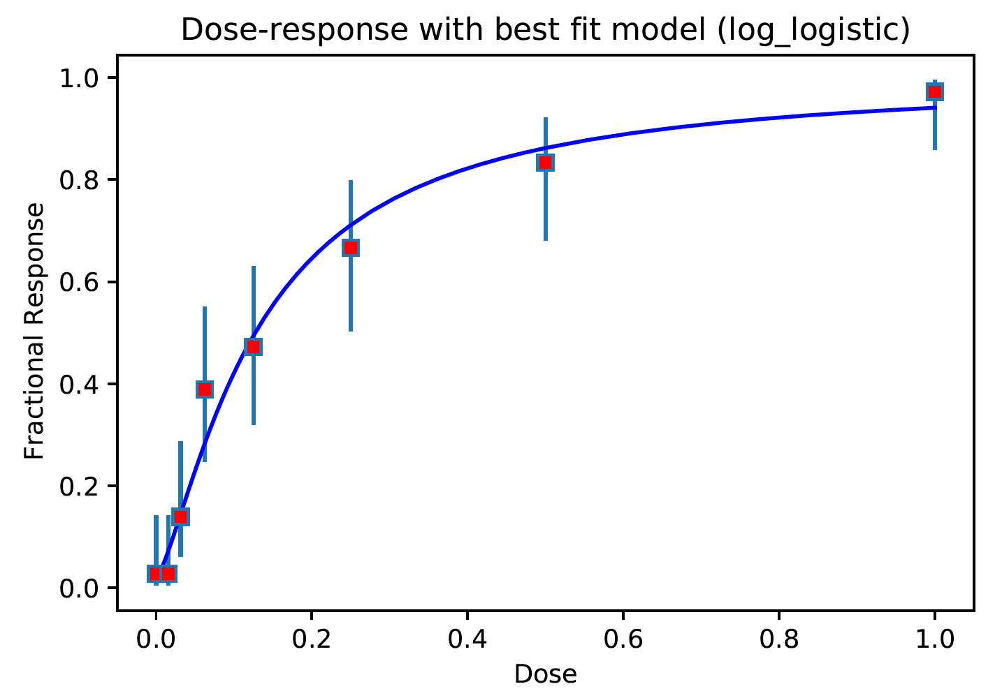
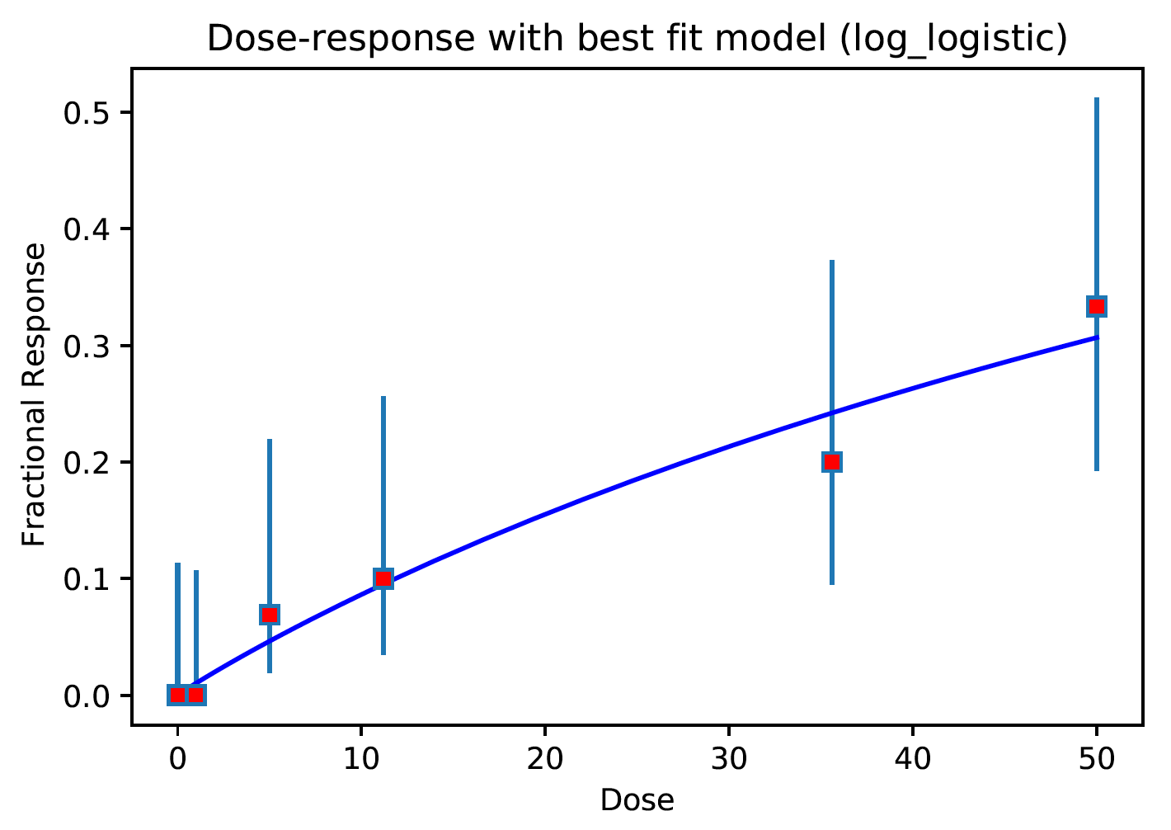
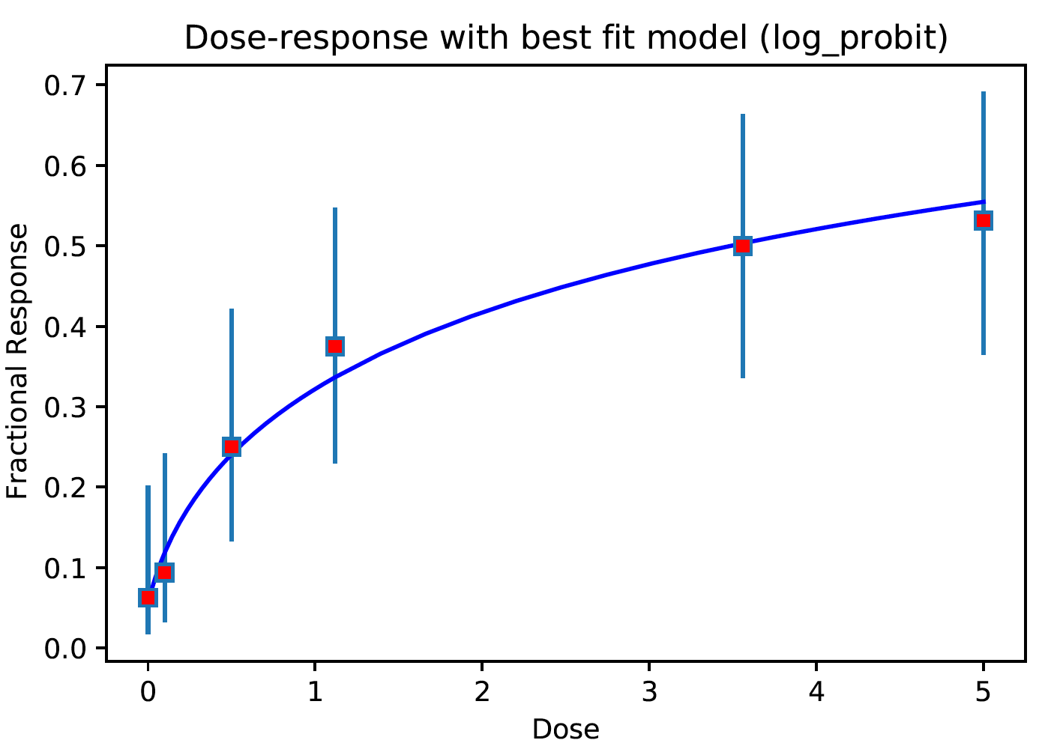
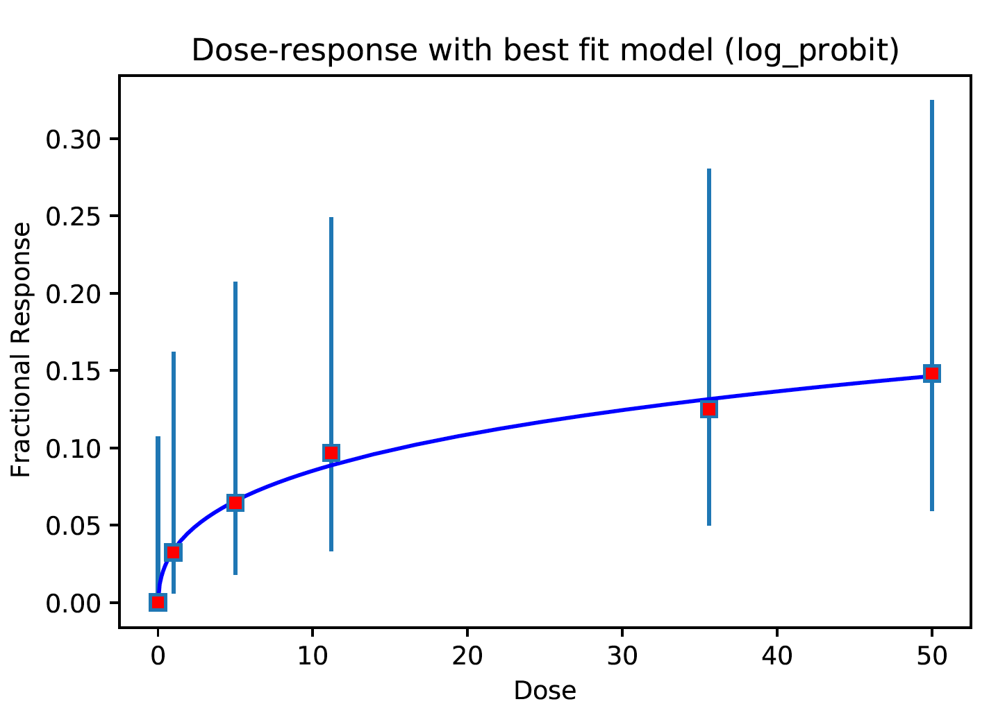
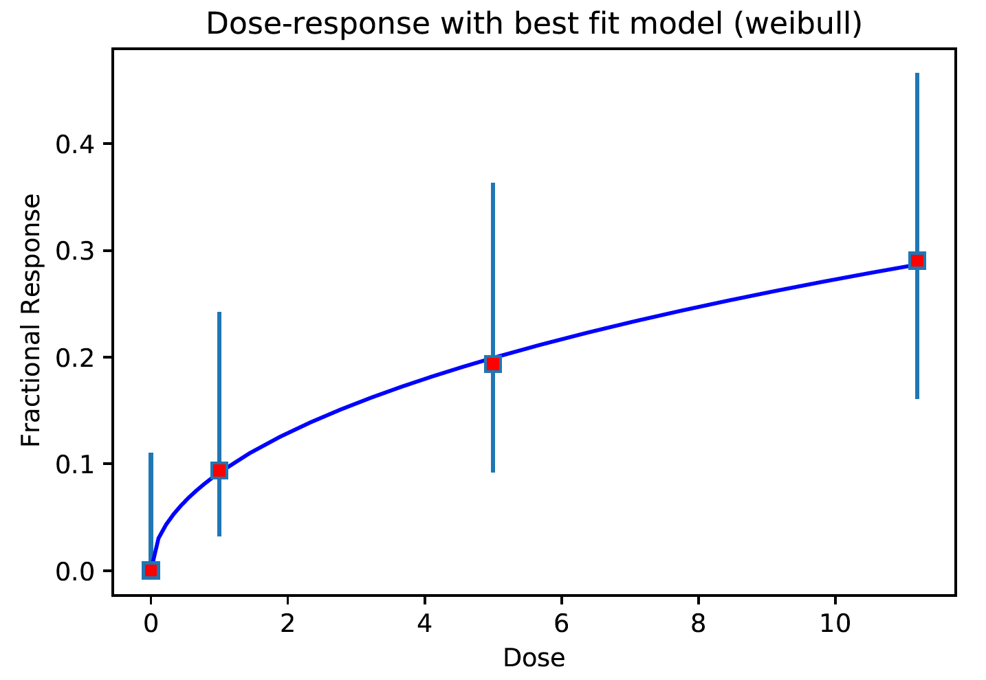
2: Very good dose-response data
Among 6,048 cases (=336 chemicals x 18 endpoints),
32 cases are qc=2

Slide 10
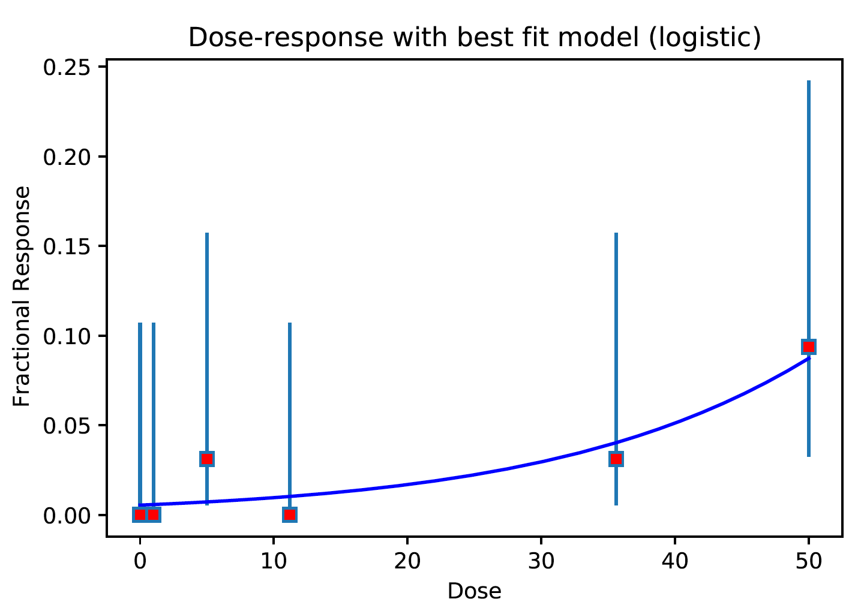
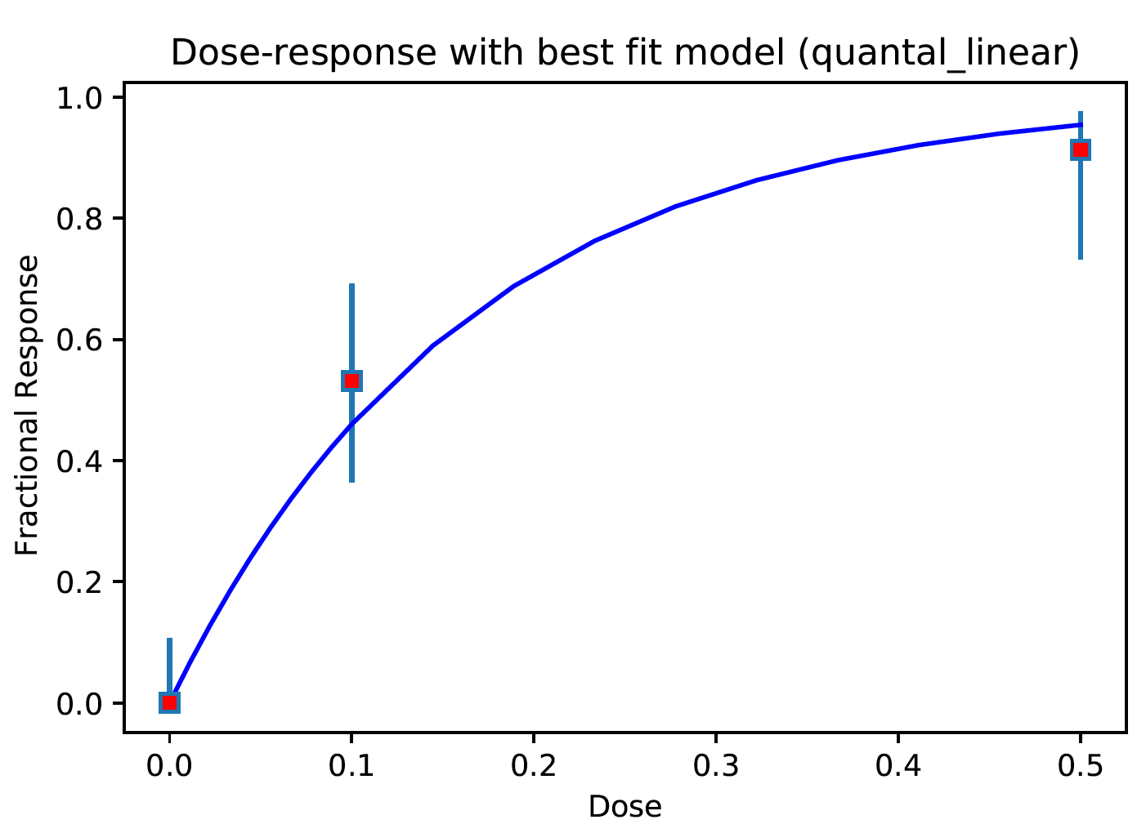
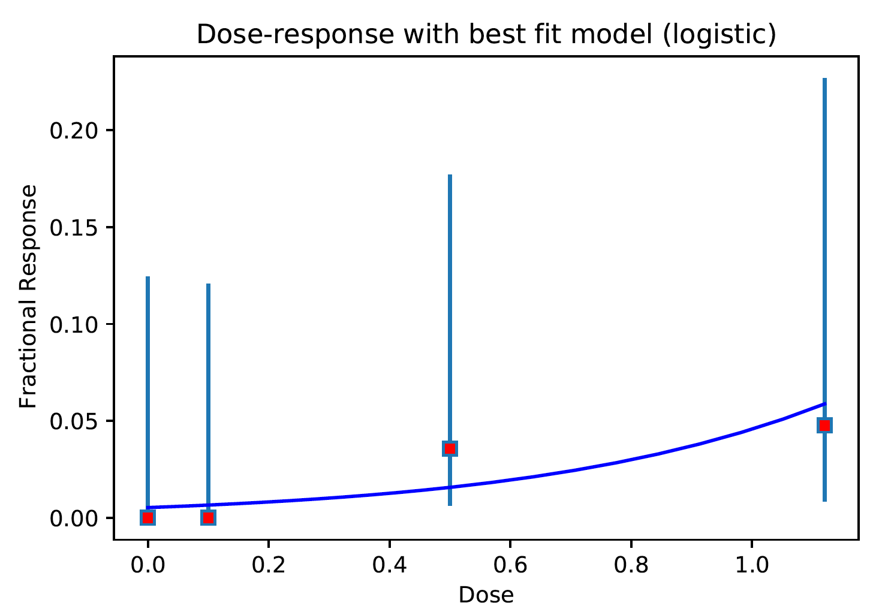
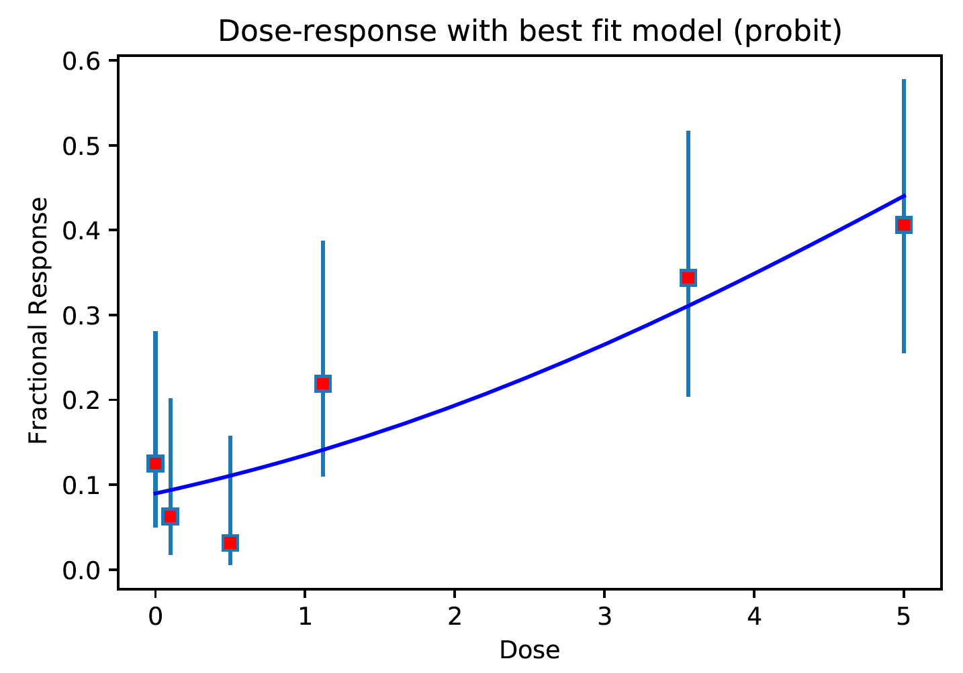
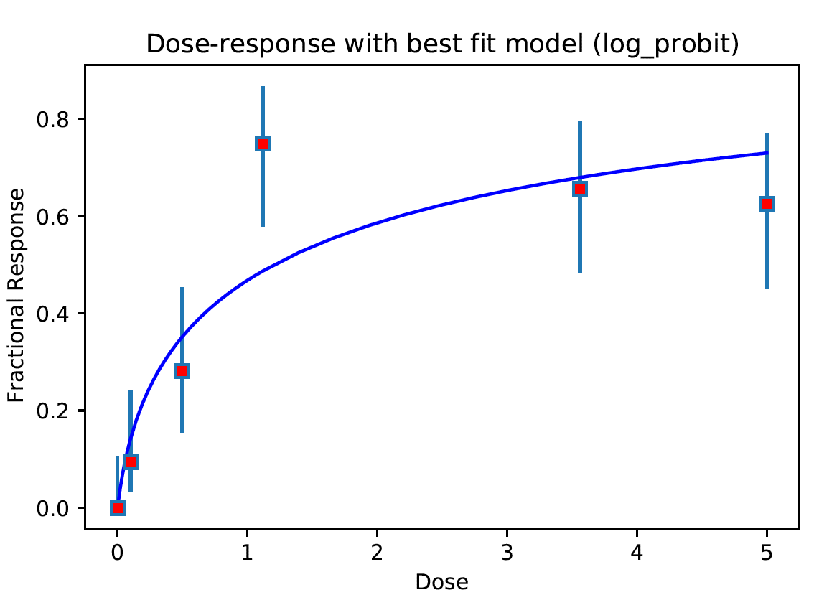
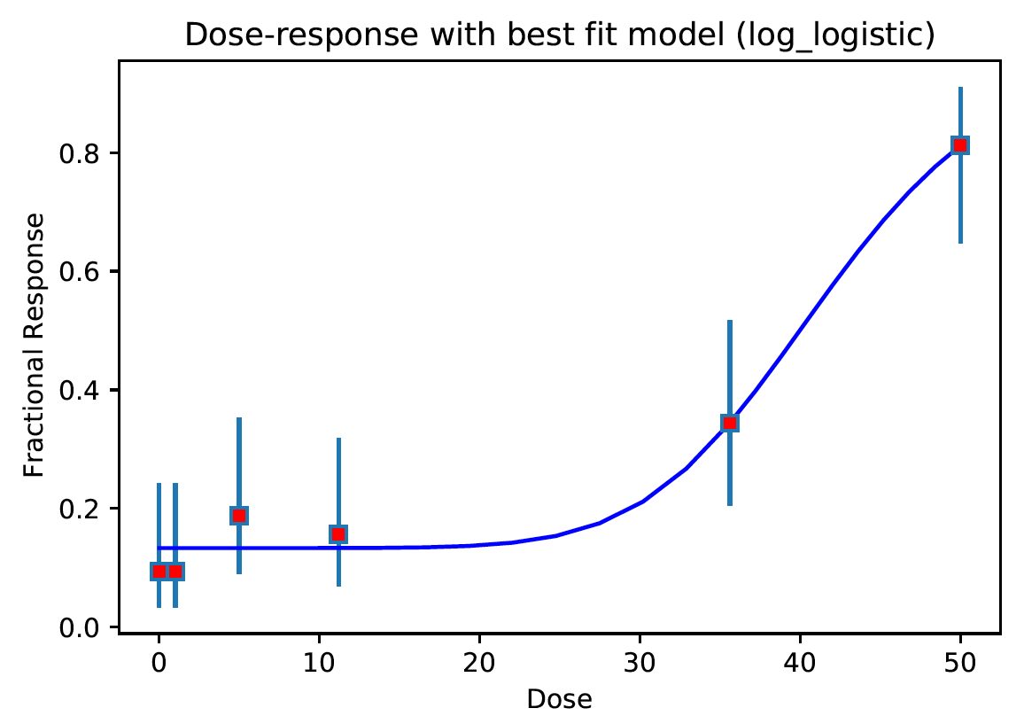
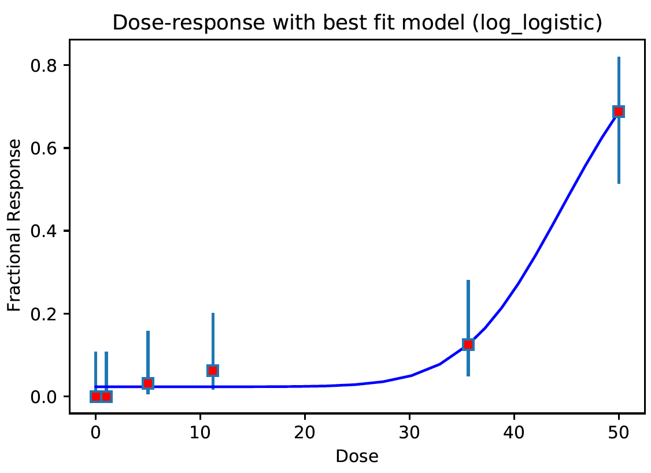
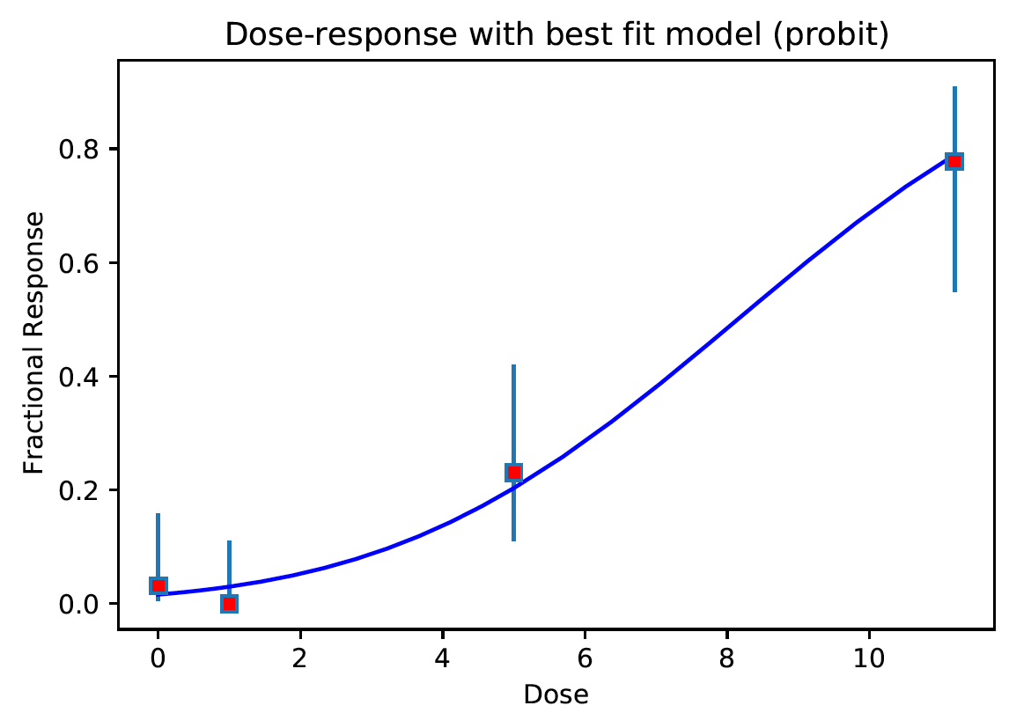
3: Good dose-response data. (BMD analysis might be less reliable though)
Among 6,048 cases (=336 chemicals x 18 endpoints),
697 cases are qc=3

Slide 11
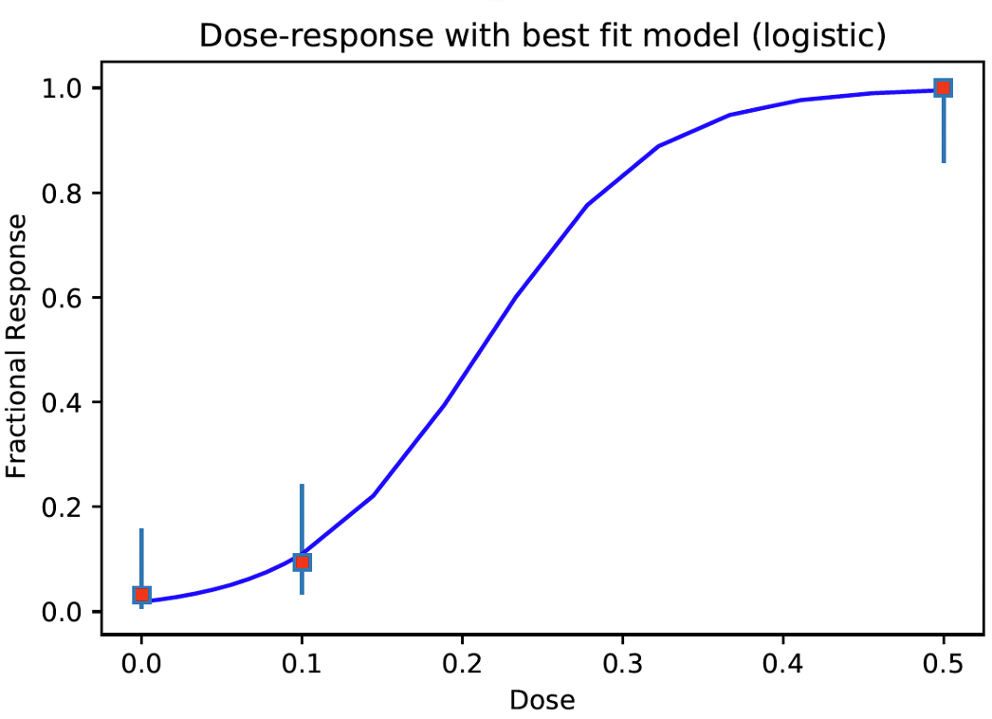
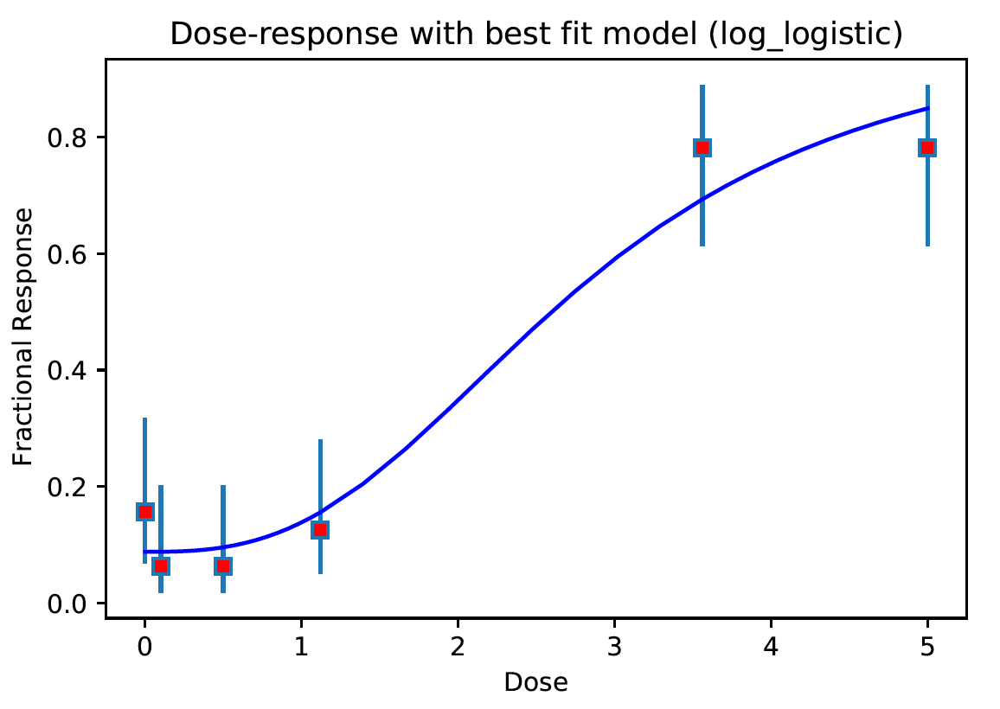
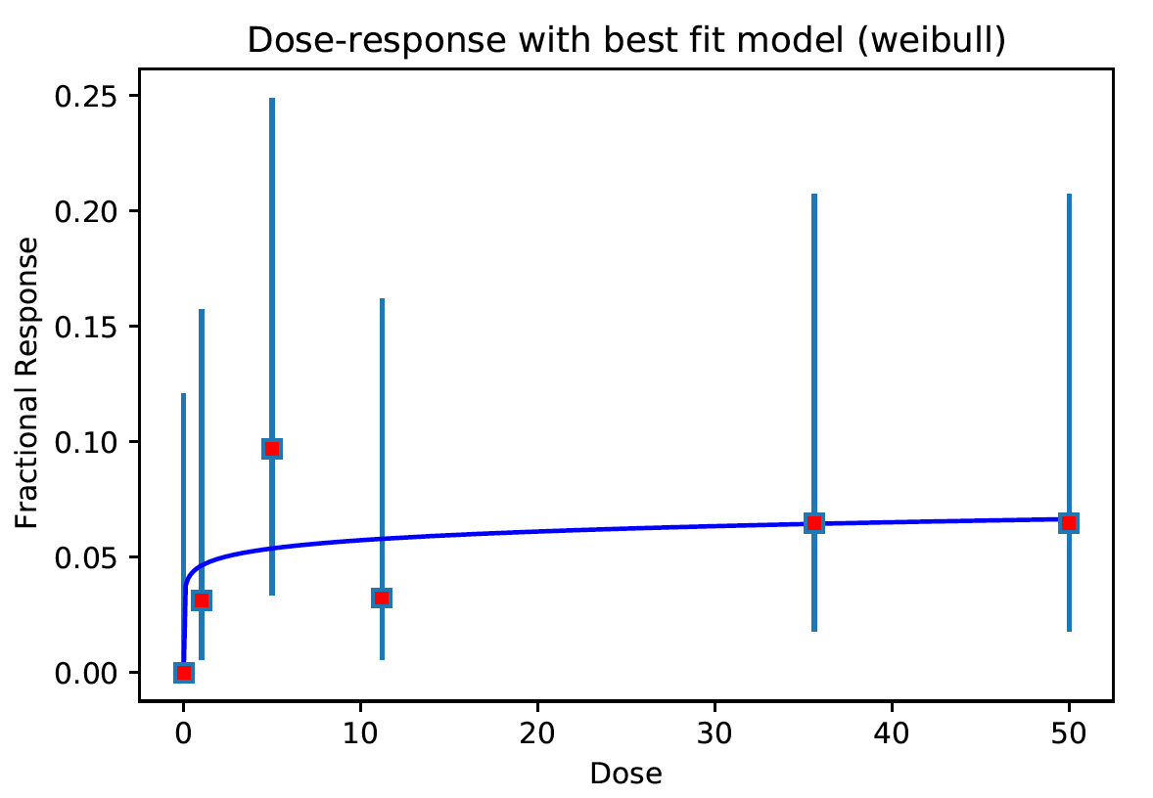
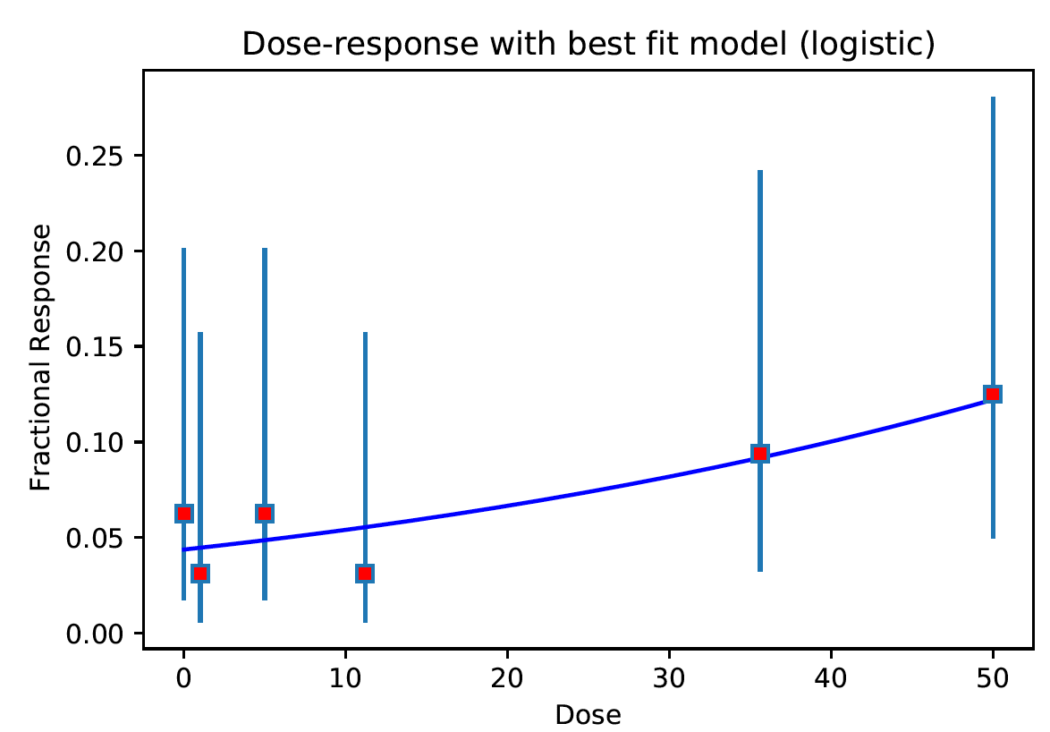
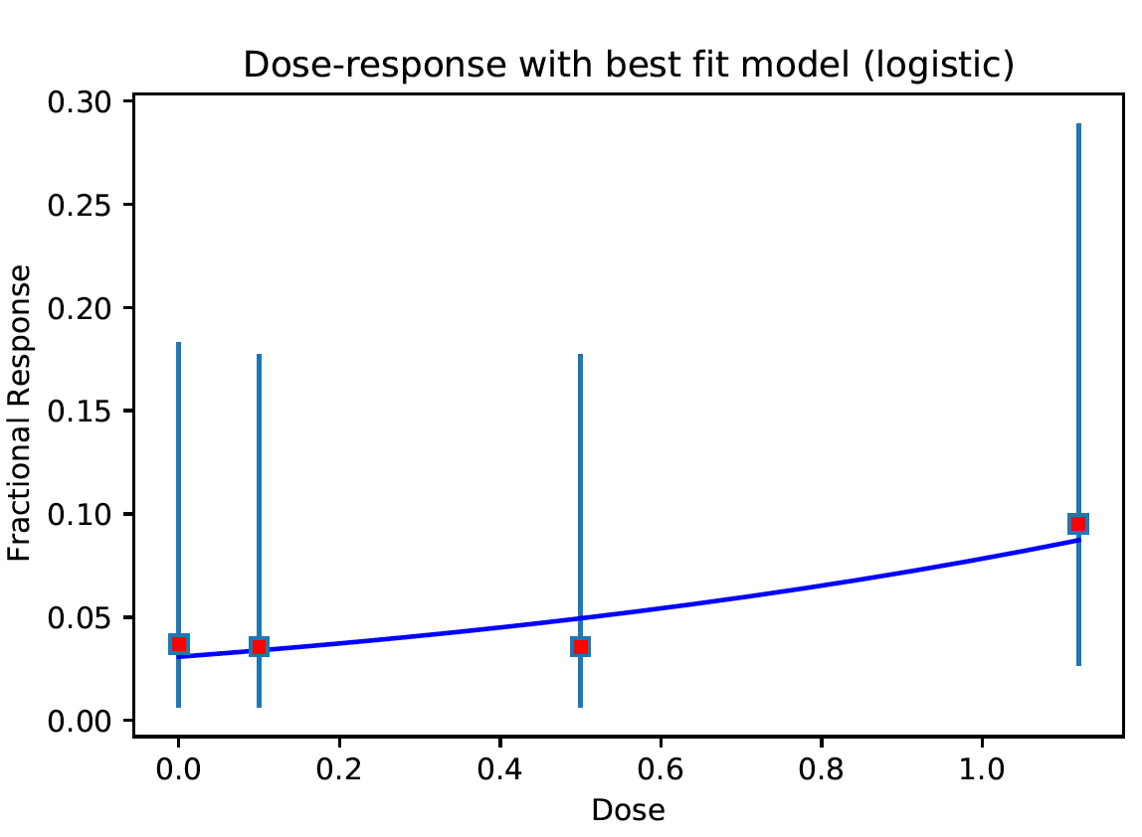
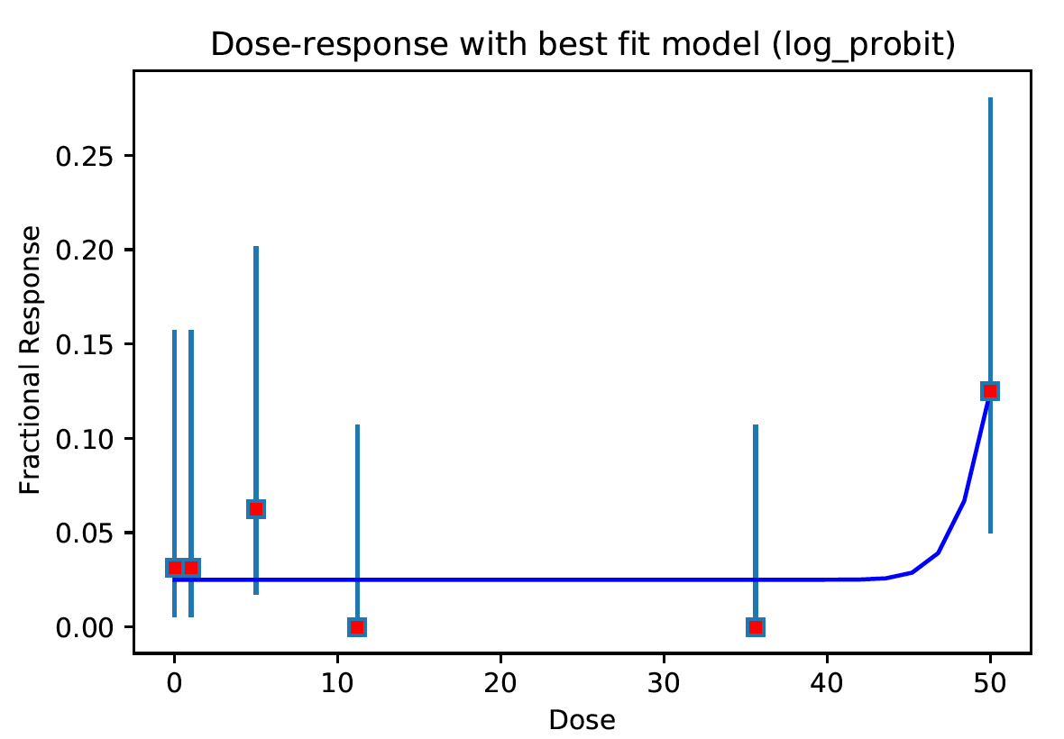
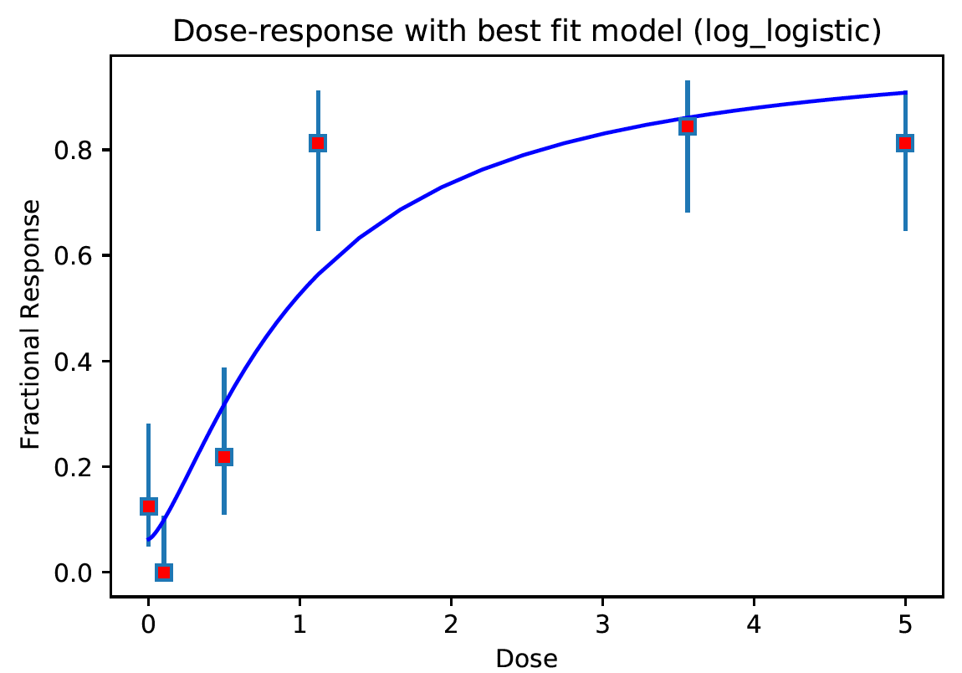
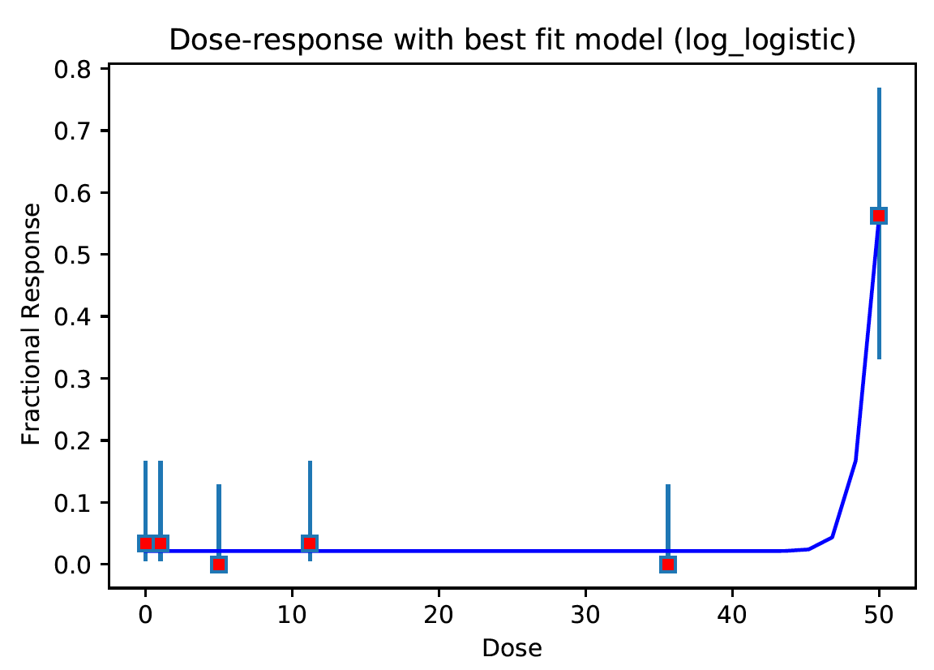
4: Data resolution poor. BMD analysis might be unreliable
Among 6,048 cases (=336 chemicals x 18 endpoints),
1,056 cases are qc=4

Slide 12
As for the data Quality Control requirement, the current criteria considers data unfit for BMD analysis if under any one of the following three cases
There are fewer than 3 dose groups
If the average response for the first two dose groups is higher than the average response at the last two dose groups indicating an overall decreasing trend
If the mean first order differences of responses is 0 indicating a flat response (determined by a t-test with p-value threshold of 0.62, i.e. inside +/- 0.5 sigma)

Slide 13
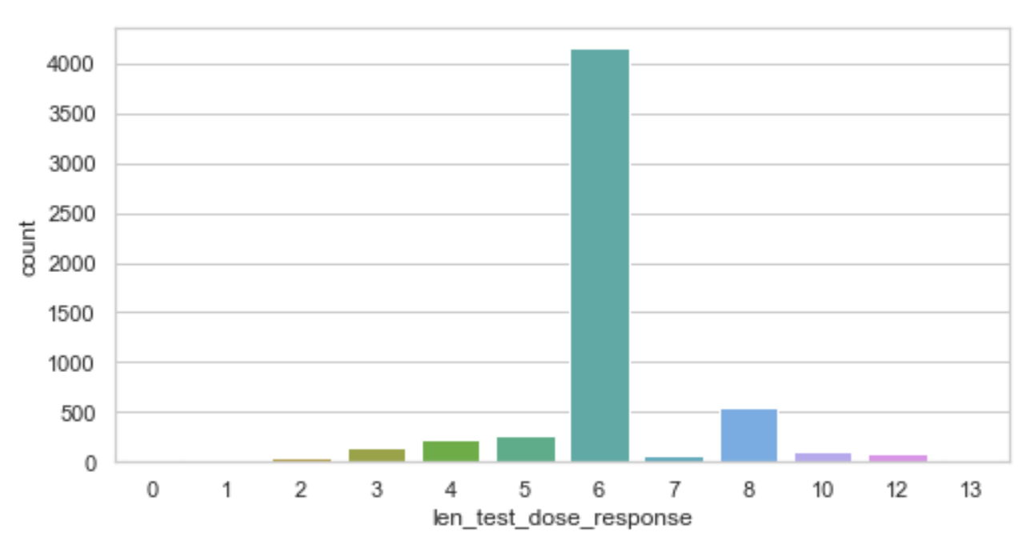

6 and 8 are the most frequent dose group numbers
Analyzed 5,712 cases (=336 chemicals x 17 endpoints),
89 cases have < 3 dose groups
Analyzed 6,048 cases (=336 chemicals x 18 endpoints)

Slide 14
Paritosh’s code reports about all chemicals
phase I and II have 336 chemicals in total.
Paritosh’s code reports about all these chemicals even their heterogenous data and model success differences.

Slide 15

Paritosh’s code can handle all cases of dose groups.
Well # | Chemical concentration
A01 | 34
A02 | 34
A03 | 34
A04 | 34
A05 | 34
A06 | 34
A07 | 34
A08 | 34
A09 | 34
A10 | 34
A11 | 34
A12 | 34
B01 | 18
B02 | 18
B03 | 18
B04 | 18
B05 | 18
B06 | 18
B07 | 18
B08 | 18
B09 | 18
B10 | 18
B11 | 18
B12 | 18
It can handle unusual number of dose groups
(e g. 8 dose groups as well
It can handle unusual representation/order of wells
Well # | Chemical concentration
E01 | 64
E02 | 6.4
E03 | 0.64
E04 | 0.064
E05 | 0.0064
E06 | 0

Slide 16

If the mean first order differences of responses is 0 indicating a flat response (determined by a t-test with p-value threshold of 0.62, i.e. inside +/- 0.5 sigma)
Red dot → response in
dose_response_vals
Blue bar → confidence interval
(low, high)

Slide 17
If the mean first order differences of responses is 0 indicating a flat response (determined by a t-test with p-value threshold of 0.62, i.e. inside +/- 0.5 sigma)
After several trials (manually spot-checking dose-response data), Paritosh empirically determined 0.62 p-value as the most reasonable threshold that included some low-quality dose-response data while still excluding extremely poor dose-response data
This value could be adjusted if required. Perhaps the best way to go about this would be to identify several dose-response cases by manually examining dose-response data where the current threshold appears to be too stringent – basically what Paritosh did to determine the threshold

Slide 18


If the mean first order differences of responses is 0 indicating a flat response (determined by a t-test with p-value threshold of 0.62, i.e. inside +/- 0.5 sigma)
Data resolution poor. Caution advised.
Best model found:log_logistic
This current threshold (p-value 0.62)
is lenient (e.g. it includes cases even when there
is only one
Dose where the response is higher than the baseline)
Data resolution poor. Caution advised.
Best model found:logistic

Slide 19
Summary
Doo nam have been co-developing with ~20 other python developers including many berkeley national lab staffs.
Among these, Paritosh’s code is one of the best ones with respect to perfection of dealing in heterogeneous data and organization (even Doo Nam can understand within few hrs).
Of course, there was a hiccup regarding a python dependency. However, it was just scipy versioning issue that even Doo nam may have faced similarly. We all solved the issue now and will provide docker image.

